Slide 1
A primer on Mixed-Effects Models
Gonzalo García-Castro
25th March 2020

Slide 2
First of all…

Slide 3
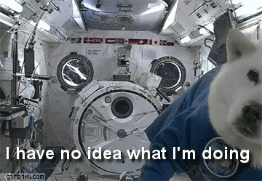
Disclaimer
I'm not a trained statistician
Don't trust me (too much)
Mistakes may (will) be made
I'm not 100% sure about anything
Probably, none of us will ever be
So let's get to it!

Slide 4
Notation
Linear Mixed-Effects Models = LMM
Mixed Models (aka. Mixed-Effects Models, aka. Multilevel Models, aka. Hierarchical Models, aka. Nested Data Models, aka. Random Parameter Models, aka. Split-Plot Designs)
If by the end of this presentation you have an intuition about why all these labels refer to the same thing: Yay! You have made so much progress.

Slide 5

Disclaimer (bonus 1)
We need to learn a bit about programming.

Slide 6
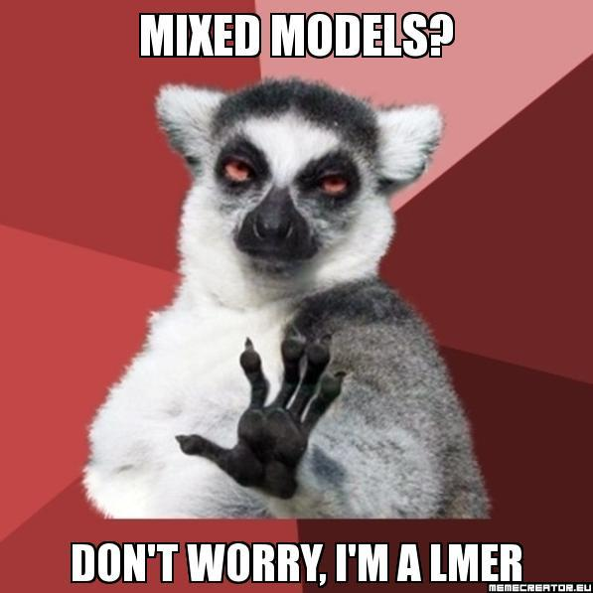
Disclaimer (bonus 2)
Most statistical literature on LMM uses R (e.g., lmer() function of the lme4 package)

Slide 7
Disclaimer (bonus 2)
Many other programming languages support LMM:
Python: statsmodels library, Pymer4
Matlab: Statistics and Machine Learning Toolbox
Julia (explicitely created for LMM)
Stan: Bayesian modelling, with interfaces with R, Python and Matlab)
I don't assume you are familiar with R, but I will use some R code for illustration purposes.

Slide 8
Materials
Some recommended reads.

Slide 9
Materials: Books and book chapters
Navarro, D. J. (2015). Learning statistics with r: A tutorial for psychology students and other beginners. [INTRO – No LMM]
Field, A., Miles, J., & Field, Z. (2012). 19. Multilevel linear models. In Discovering statistics using r. SAGE Publications. [INTRO]
Winter, B. (2019). Statistics for linguists: An introduction using R. Routledge. [INTRO]
Mirman, D. (2016). 4. Structuring random effects. In Growth curve analysis and visualisation using r. CRC press. [MEDIUM – Generalisation]
Gelman, A., & Hill, J. (2006). Data analysis using regression and multilevel/hierarchical models. Cambridge University press. [MEDIUM]
Fox, J., & Weisberg, S. (2018). An r companion to applied regression. SAGE publications. [MEDIUM]
McElreath, R. (2020). Statistical rethinking: A bayesian course with examples in r and stan. CRC press. [DIFFICULT]

Slide 10
Materials: Articles
Winter, B. (2013). Linear models and linear mixed effects models in R with linguistic applications. arXiv Preprint arXiv:1308.5499. https://arxiv.org/abs/1308.5499 [INTRO]
DeBruine, L., & Barr, D. J. (2019). Understanding mixed effects models through data simulation. https://doi.org/10.31234/osf.io/xp5cy [INTRO]
Barr, D. J., Levy, R., Scheepers, C., & Tily, H. J. (2013). Random effects structure for confirmatory hypothesis testing: Keep it maximal. Journal of Memory and Language, 68(3), 255–278. [MEDIUM]
Barr, D. J. (2013). Random effects structure for testing interactions in linear mixed-effects models. Frontiers in Psychology, 4, 328. https://www.frontiersin.org/articles/10.3389/fpsyg.2013.00328/full [MEDIUM]
Bates, D., Kliegl, R., Vasishth, S., & Baayen, H. (2015a). Parsimonious mixed models. arXiv Preprint arXiv:1506.04967. https://arxiv.org/pdf/1506.04967.pdf [MEDIUM]
Baayen, R. H., Davidson, D. J., & Bates, D. M. (2008). Mixed-effects modelling with crossed random effects for subjects and items. Journal of Memory and Language, 59(4), 390–412. https://doi.org/10.1016/j.jml. 2007.12.005 [DIFFICULT]
Barr, D. J. (2008). Analyzing “visual world” eyetracking data using multilevel logistic regression. Journal of Memory and Language, 59(4), 457–474. https://doi.org/10.1016/j.jml.2007.09.002 [DIFFICULT]

Slide 11
Materials: Articles (special mentions)
Meteyard, L., & Davies, R. A. (2020). Best practice guidance for linear mixed-effects models in psychological science. Journal of Memory and Language, 112, 104092. https://doi.org/10.1016/j.jml.2020.104092
Bates, D., Mächler, M., Bolker, B., & Walker, S. (2015b). Fitting linear mixed-effects models using lme4. Journal of Statistial Software, 67(1). https://doi.org/10.18637/jss.v067.i01

Slide 12
Modelling
A reminder.

Slide 13
Modelling: What for?
To estimate a parameter that characterises a population using data from samples of that population.
This unknown parameter can be whatever we want:
Central tendency measures (e.g., mean, median)
Dispersion measures (e.g., standard deviation)
Measures of association between variables (e.g., coefficients)
We usually estimate all of them when analysing data and perform some kind of statistical inference from them.

Slide 14
Modelling: What for?
In confirmatory analyses, we:
Hypothesise that the parameter is within a range of values
Collect data
Perform statistical inference
Frequentist approach: what is the probability of our data, assuming our hypothesis is true?
Bayesian approach: what is the probability of our hypothesis, given the data?

Slide 15
Modelling: What for?
In experimental confirmatory research, we are usually interesed in estimating the association between two or more variables:
Age (predictor) and vocabulary size (outcome)
Bilingualism (predictor) and novelty preference (outcome)
Native linguistic rythmic class (predictor) and entrainment to speech signal (outcome)
We try draw a shape (e.g., line, curve) that defines this relationship.
For now, we will stick to óne shape: lines.

Slide 16
Modelling: What for?
The three (four, sometimes) steps of modelling:
Model specification: what variables am I going to include in the model?
Model fitting: what line fits data the best?
Statistical inference: Does my model fit data good enough? What is the contribution of each predictor to the goodness of fit?
Model validation: Does my model predict new outcomes correctly?

Slide 17
Modelling: 1) Model specification
We need to define what outcomes and predictors I am interested in.
e.g., what am I trying to predict? What variables am I using to predict it?
What are my assumptions about how they relate to the outcome?
e.g., linearity, normality of residuals
What are my assumptions about how each predictor relates to the other predictors?+
e.g., do I expect interactions between predictors?

Slide 18
Modelling: 1) Model specification
We will work with linear models
This means that we will try to draw a line that defines the relationship between predictors and outcome.
But bear in mind that non-linear models exist as well
For instance, we may need/want to fit a curve or an exponential function
e.g., Growth Curve Analysis

Slide 19
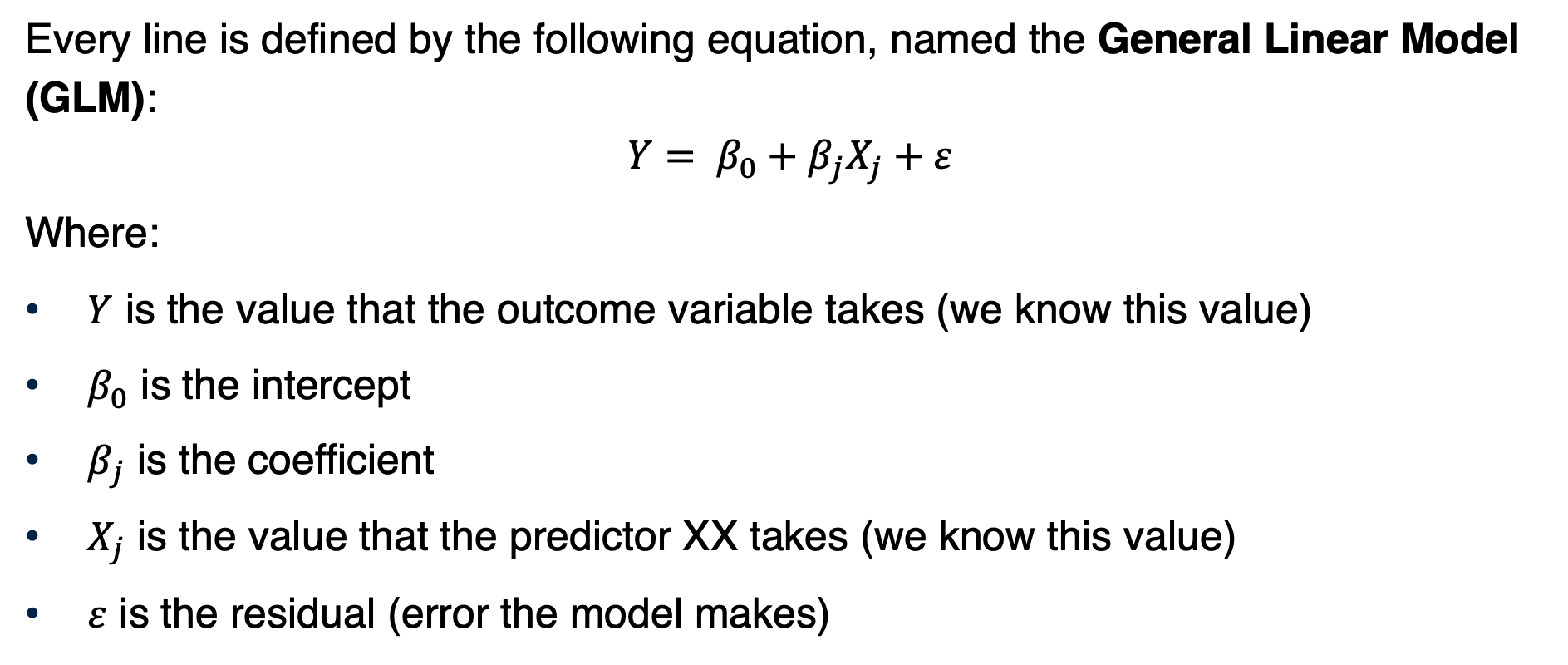
Modelling: 1) Model specification
Every line is defined by the following equation, named the General Linear Model (GLM):
$$Y= β_{0}+β_{j}X_{j}+ε$$
Where:
$Y$ is the value that the outcome variable takes (we know this value)
$β_{0}$ is the intercept
$β_{j}$ is the coefficient
$X_{j}$ is the value that the predictor XX takes (we know this value)
$ε$ is the residual (error the model makes)

Slide 20
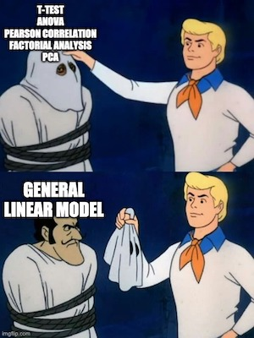
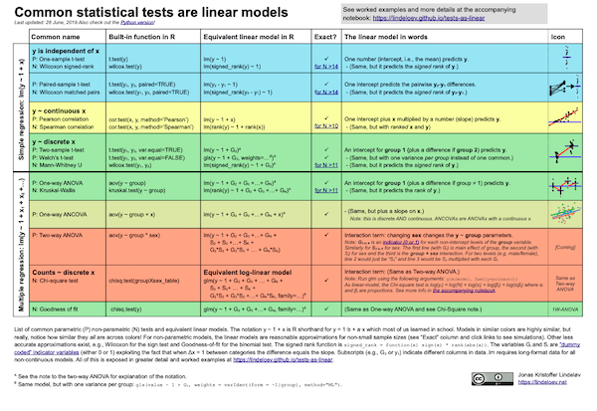
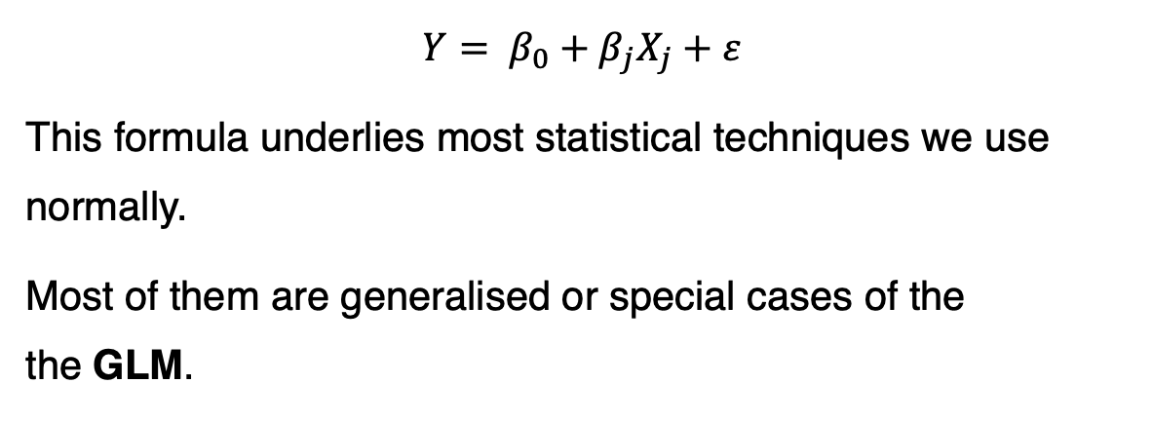
Modelling: 1) Model specification
$$Y= β_{0}+β_{j}X_{j}+ε$$
This formula underlies most statistical techniques we use normally.
Most of them are generalised or special cases of the the GLM.

Slide 21
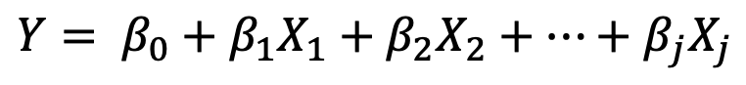
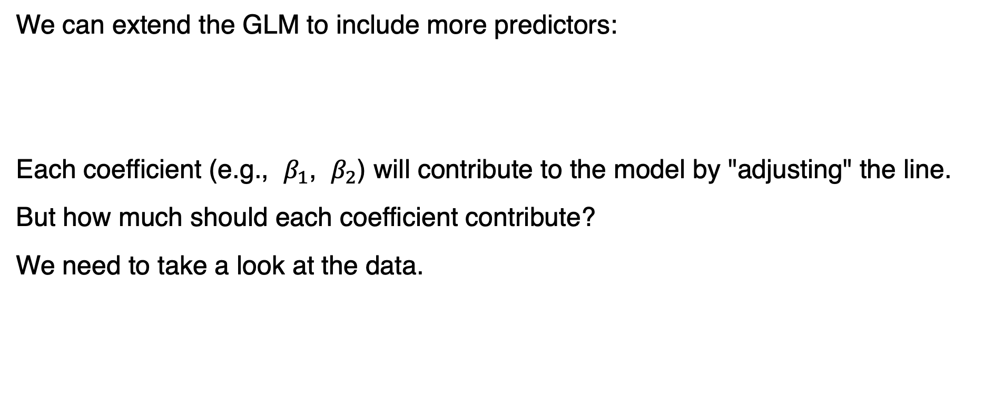
Modelling: 1) Model specification
We can extend the GLM to include more predictors:
Each coefficient (e.g., $β_{1}$, $β_{2}$) will contribute to the model by "adjusting" the line.
But how much should each coefficient contribute?
We need to take a look at the data.
$$Y= β_{0}+β_{1}X_{1}+β_{2}X_{2}+…+β_{j}X_{j}$$

Slide 22
Modelling: 1) Model specification
There are infinite lines we can draw with these parameters.
We need to find the combination of values of the coefficients β0β0 and βjβj that make the line fit data the best.
We need to find the Least Squares Regression Line
This line minimises the overall distance between the lines and the data points
How to find it? We use built-in algorithms that try a lot of combinations until finding the optimal one.
$$Y= β_{0}+β_{1}X_{1}+β_{2}X_{2}+…+β_{j}X_{j}$$

Slide 23
Modelling: 2) Model fitting
Play with regression lines:
https://antoinesoetewey.shinyapps.io/statistics-202/

Slide 24
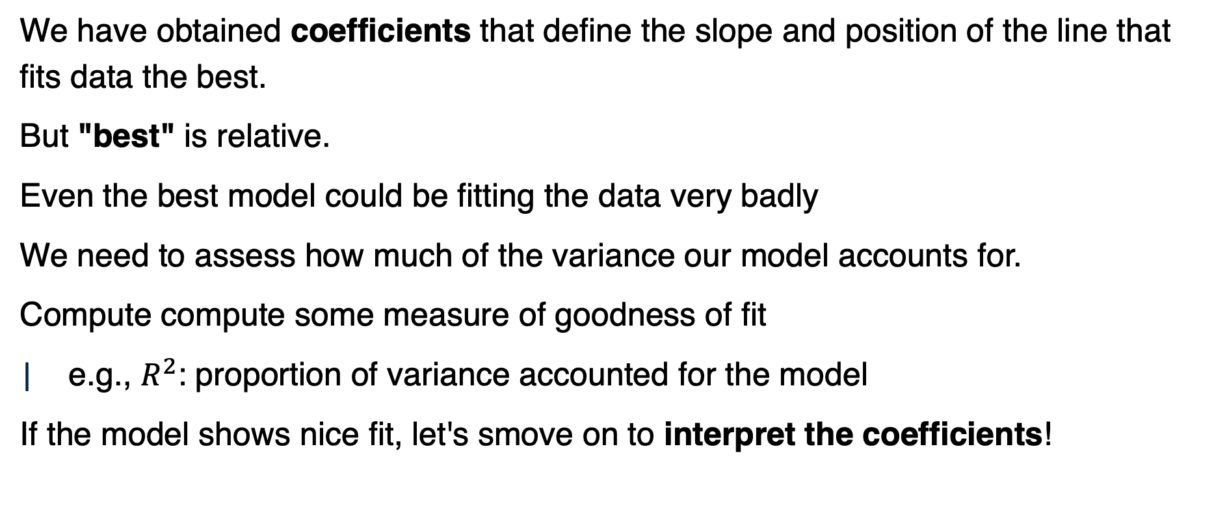
Modelling: 3) Statistical inference
We have obtained coefficients that define the slope and position of the line that fits data the best.
But "best" is relative.
Even the best model could be fitting the data very badly
We need to assess how much of the variance our model accounts for.
Compute compute some measure of goodness of fit
e.g., $R^{2}$: proportion of variance accounted for the model
If the model shows nice fit, let's smove on to interpret the coefficients!

Slide 25
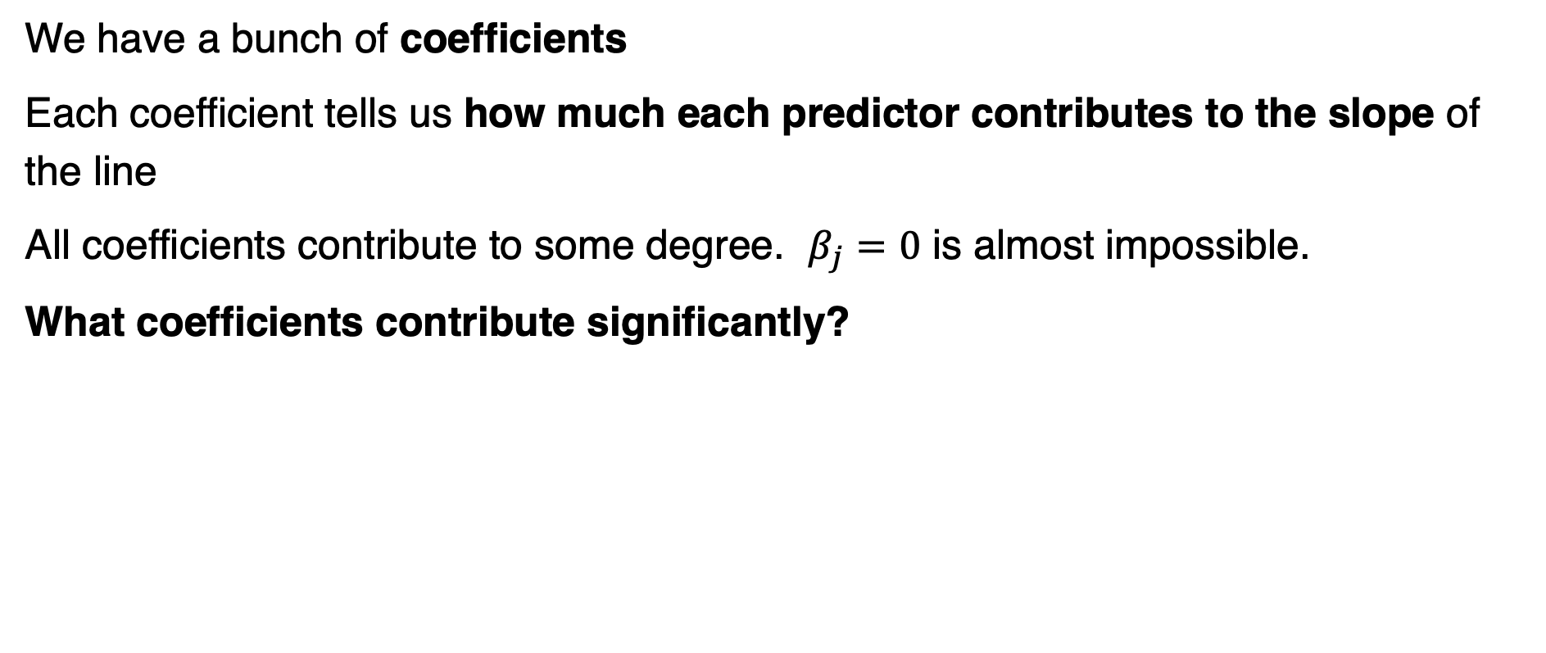
Modelling: 3) Statistical inference
We have a bunch of coefficients
Each coefficient tells us how much each predictor contributes to the slope of the line
All coefficients contribute to some degree. $β_{j}=0$ is almost impossible.
What coefficients contribute significantly?

Slide 26
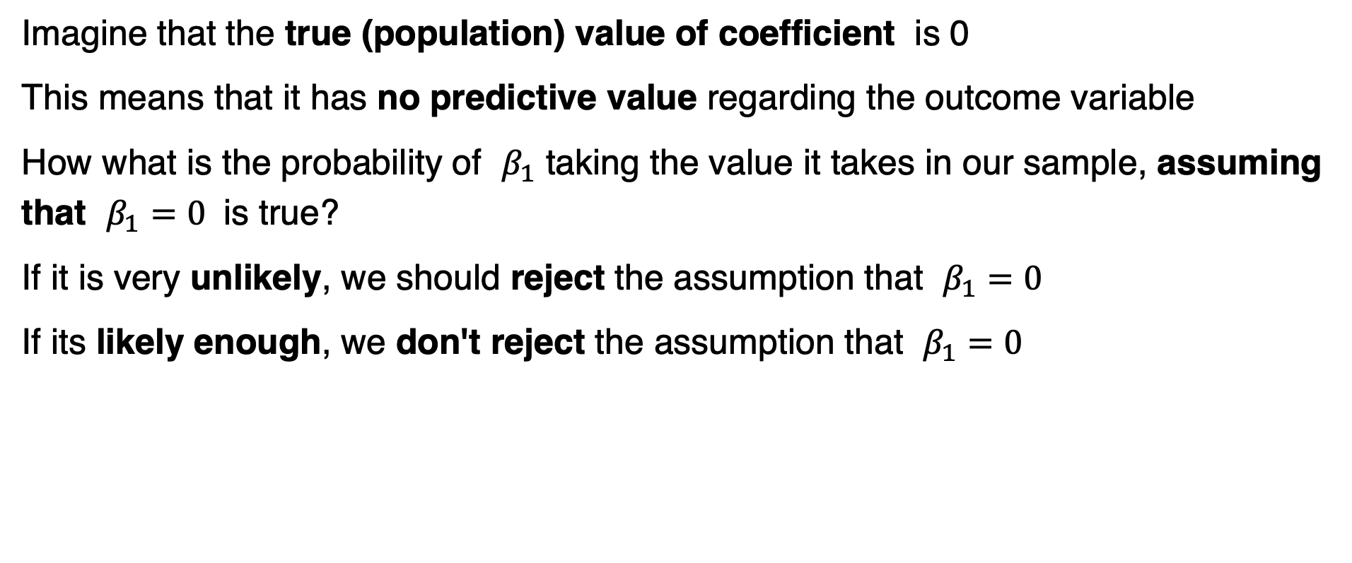
Modelling: 3) Statistical inference
Imagine that the true (population) value of coefficient is 0
This means that it has no predictive value regarding the outcome variable
How what is the probability of $β_{1}$ taking the value it takes in our sample, assuming that $β_{1}=0$ is true?
If it is very unlikely, we should reject the assumption that $β_{1}=0$
If its likely enough, we don't reject the assumption that $β_{1}=0$

Slide 27
Modelling: 3) Statistical inference
We know that coefficients in linear models tend to follow a Gaussian distribution. This distribution is known.
It tells us the probability of each value of our coefficient, assuming that its true value is 0.

Slide 28
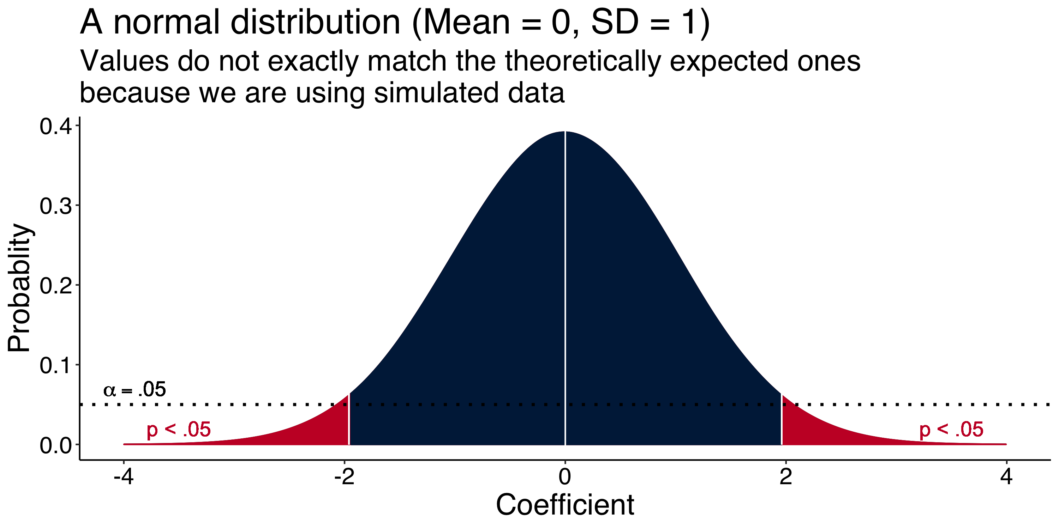
Modelling: 3) Statistical inference

Slide 29
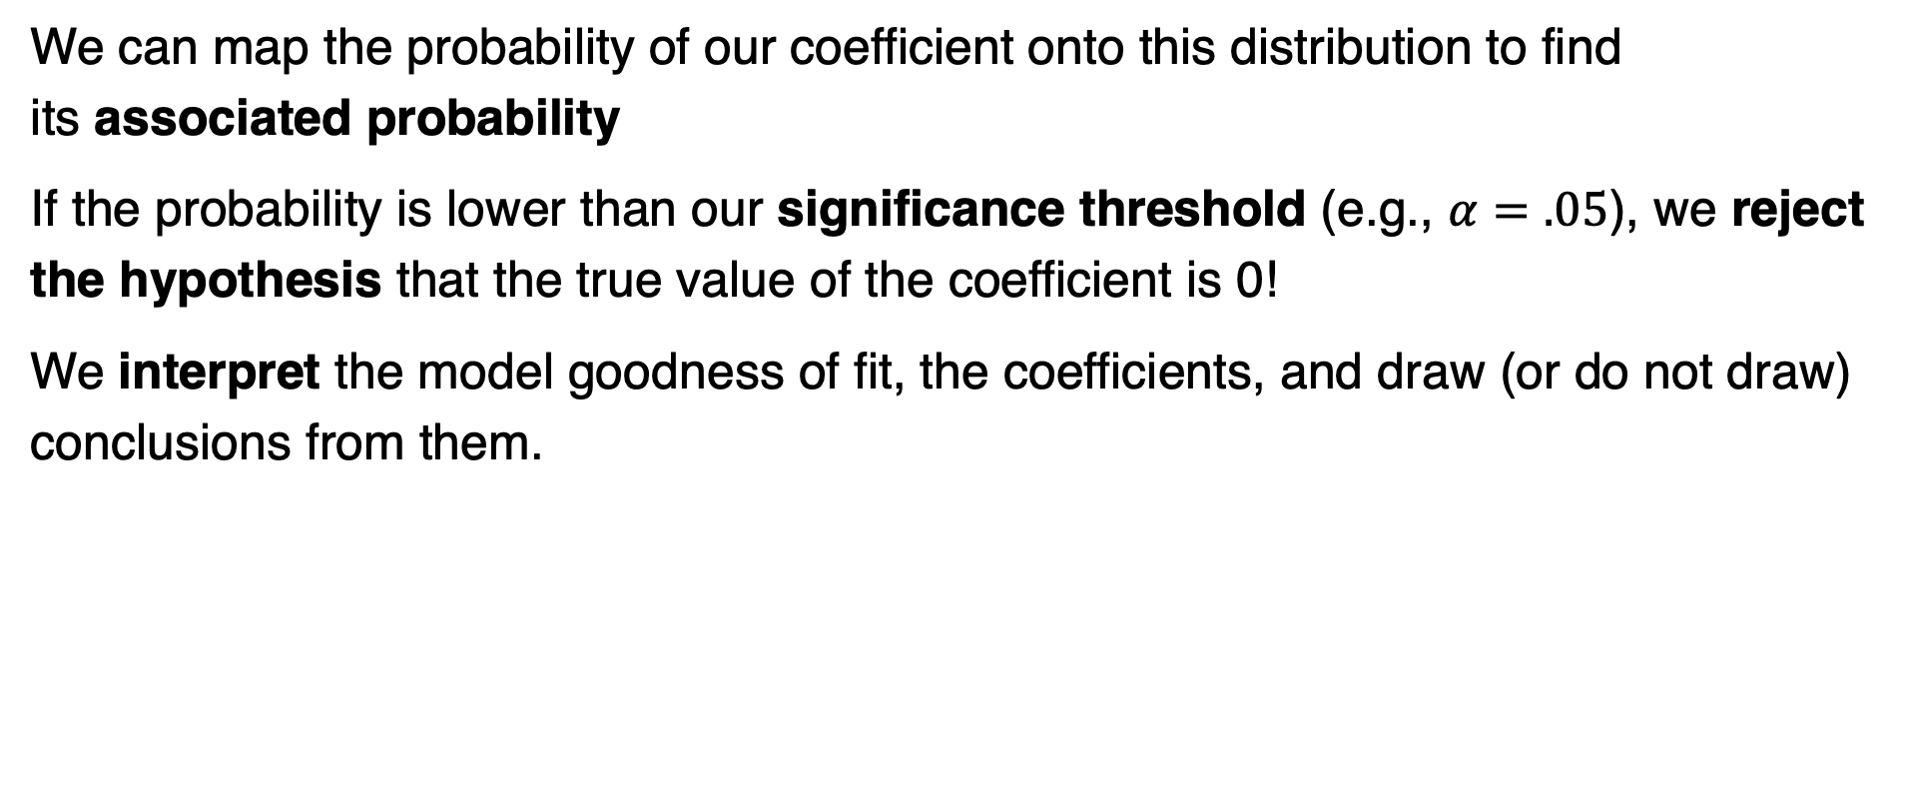
Modelling: 3) Statistical inference
We can map the probability of our coefficient onto this distribution to find its associated probability
If the probability is lower than our significance threshold (e.g., $α=.05$), we reject the hypothesis that the true value of the coefficient is 0!
We interpret the model goodness of fit, the coefficients, and draw (or do not draw) conclusions from them.

Slide 30

Modelling: Assumptions!
We assume many things, one of the, being that observations are independent from each other.
This means that the probability of one observation taking one value is independent from the value other observations have taken.

Slide 31
Introducing random effects in our linear model
Beyond fixed effects

Slide 32
What is a LMM?
An extension of the GLM that allows to account for systematic sources of variability beyond our effects of interest.
All models are inaccurate to some degree.
Sometimes, part of the error the model makes is systematic (not random).
e.g., data points from the same participant are correlated
e.g., data points from the same trial are correlated
Notes:
All models make some error when predicting each data point.
We assume this error is random.

Slide 33
Why to use a LMM
To avoid aggregating data (more statistical power)
To account for non-independence of scores
To account for hierarchical structures in our data
To account for cross-observational unit variability

Slide 34
Why to use a LMM
+
CAR
Effect of word frequency on reaction time task in a lexical decision task.
Word condition:
High frequency: CAR > Yes/No
Low frequency: FLAG > Yes/No
Non-word condition: FOIR > Yes/No
Does frequency affect reaction times (RT)?
yes no
+
FLAG
yes no
+
ROIP
yes no

Slide 35
Why to use a LMM
Participant | Trial | Frequency | RT (s)
Participant 1 | 1 | High | 0.15
Participant 1 | 2 | High | 0.38
Participant 1 | 3 | High | 0.39
Participant 1 | 4 | High | 0.11
Participant 1 | 5 | High | 0.27
Participant 1 | 6 | Low | 0.70
Participant 1 | 7 | Low | 0.24
Participant 1 | 8 | Low | 0.32
Participant 1 | 9 | Low | 0.32
Participant 1 | 10 | Low | 0.64
Participant 2 | 1 | High | 0.43
Participant 2 | 2 | High | 0.15
Participant 2 | 3 | High | 0.12
Participant 2 | 4 | High | 0.48
Participant 2 | 5 | High | 0.53
Participant 2 | 6 | Low | 1.05
Participant 2 | 7 | Low | 1.12
Participant 2 | 8 | Low | 1.01
Participant 2 | 9 | Low | 1.21
Participant 2 | 10 | Low | 1.18
… | … | ... | …
Participant 5 | 10 | Low | 3.43
Trial-wise data:
Sample size:
5 participants
10 trials each: 5 in each frequency condition
50 observations

Slide 36
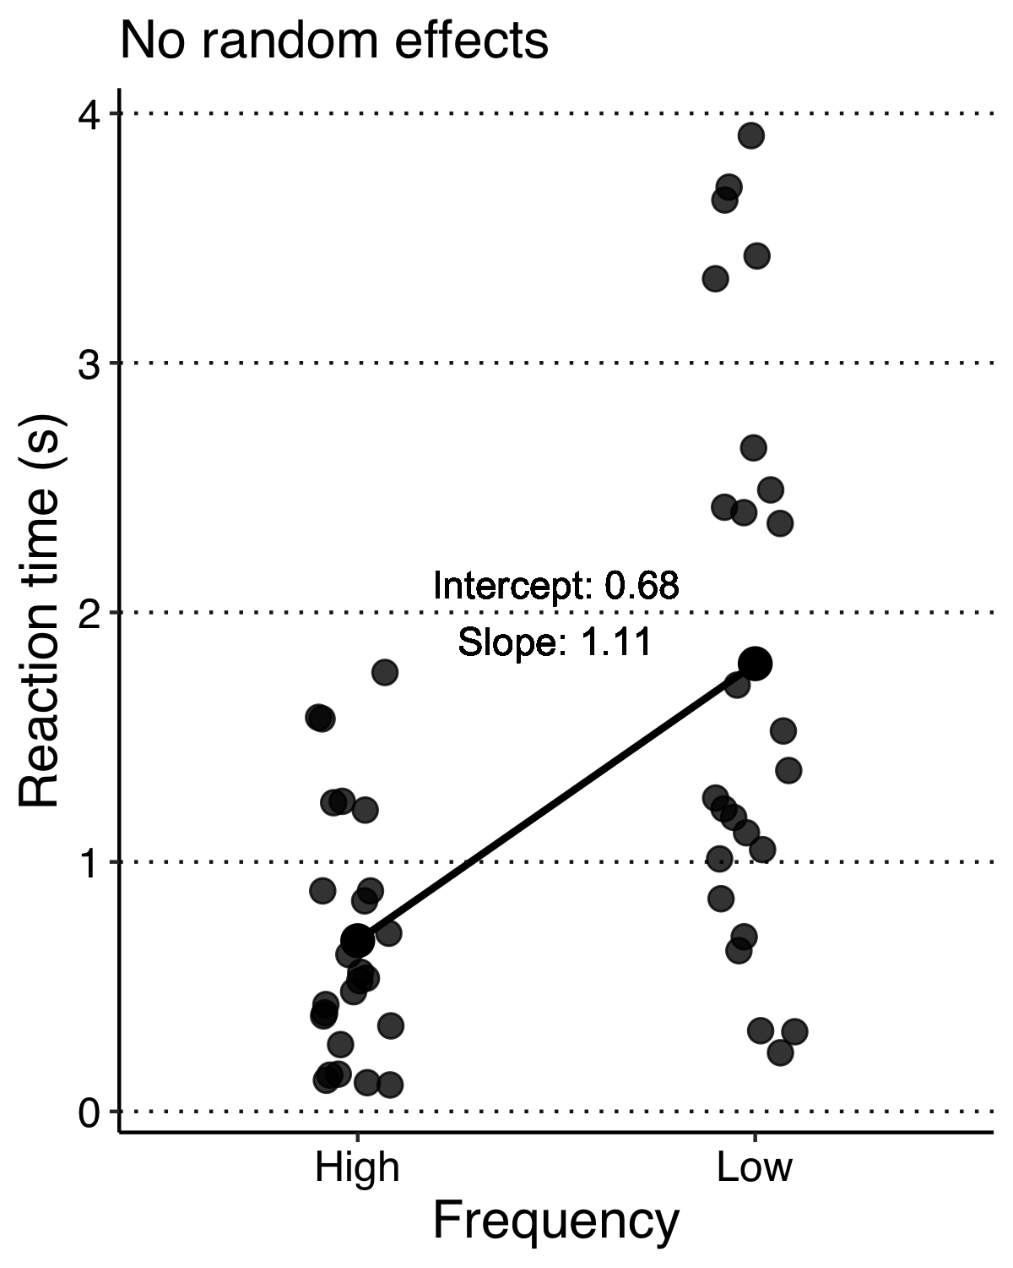
Why to use a LMM
Data-points from all participants are pooled together.
RT in high frequency condition is 0.68 s (intercept)
RT increases in 1.11 s. (slope) when in low frequency condition.
Notes:
The distribution of the residual seems to be random, appart from some heteroskedasticity (variability is larger in thelow frequency condition)

Slide 37
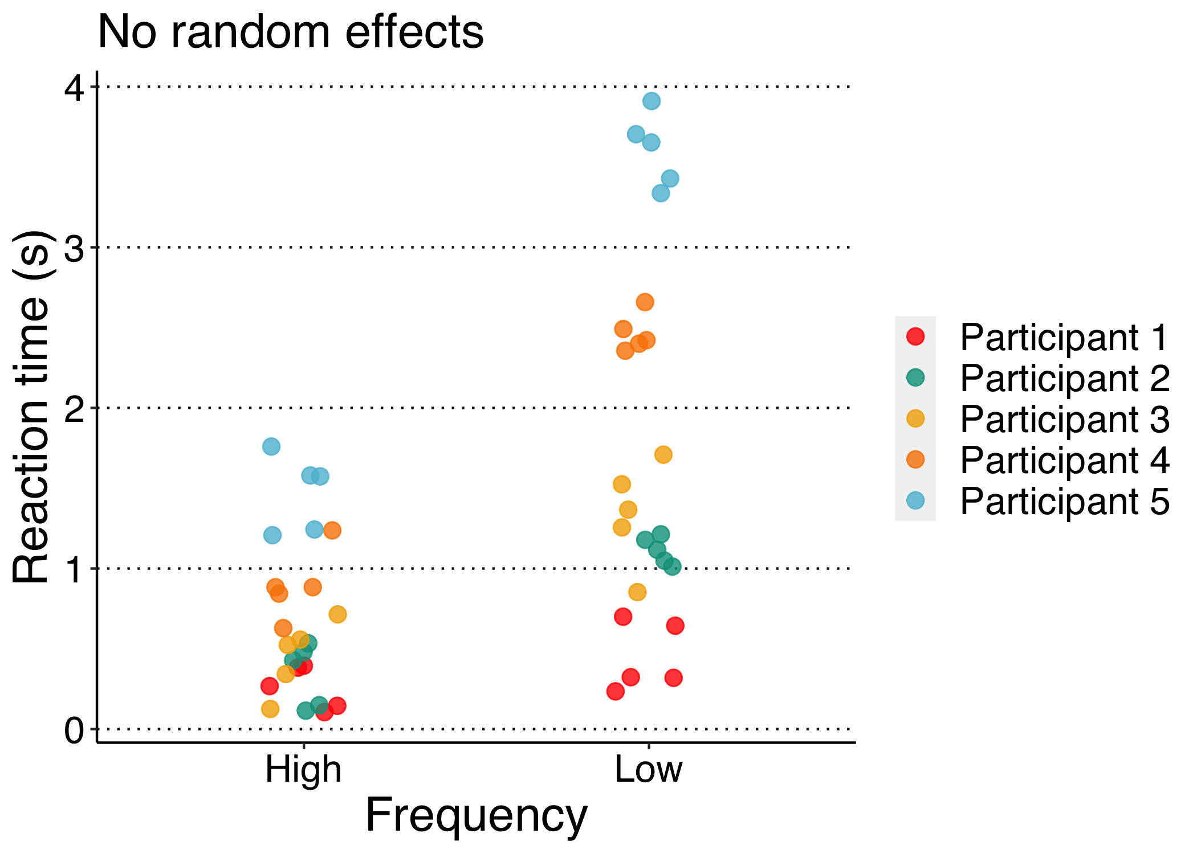
Why to use a LMM
Assumption of non-independence is hard to assume here.
Part of the variability is due to systematic differences across participants.

Slide 38
Why to use a LMM
Participant | Frequency | Mean RT (s)
Participant 1 | High | 0.26
Participant 1 | Low | 0.44
Participant 2 | High | 0.34
Participant 2 | Low | 1.11
Participant 3 | High | 0.45
Participant 3 | Low | 1.34
Participant 4 | High | 0.90
Participant 4 | Low | 2.47
Participant 5 | High | 1.47
Participant 5 | Low | 3.61
A common practice to avoid this is to aggregate data points across trials for each participant
e.g., mean RT across trials in each condition.

Slide 39
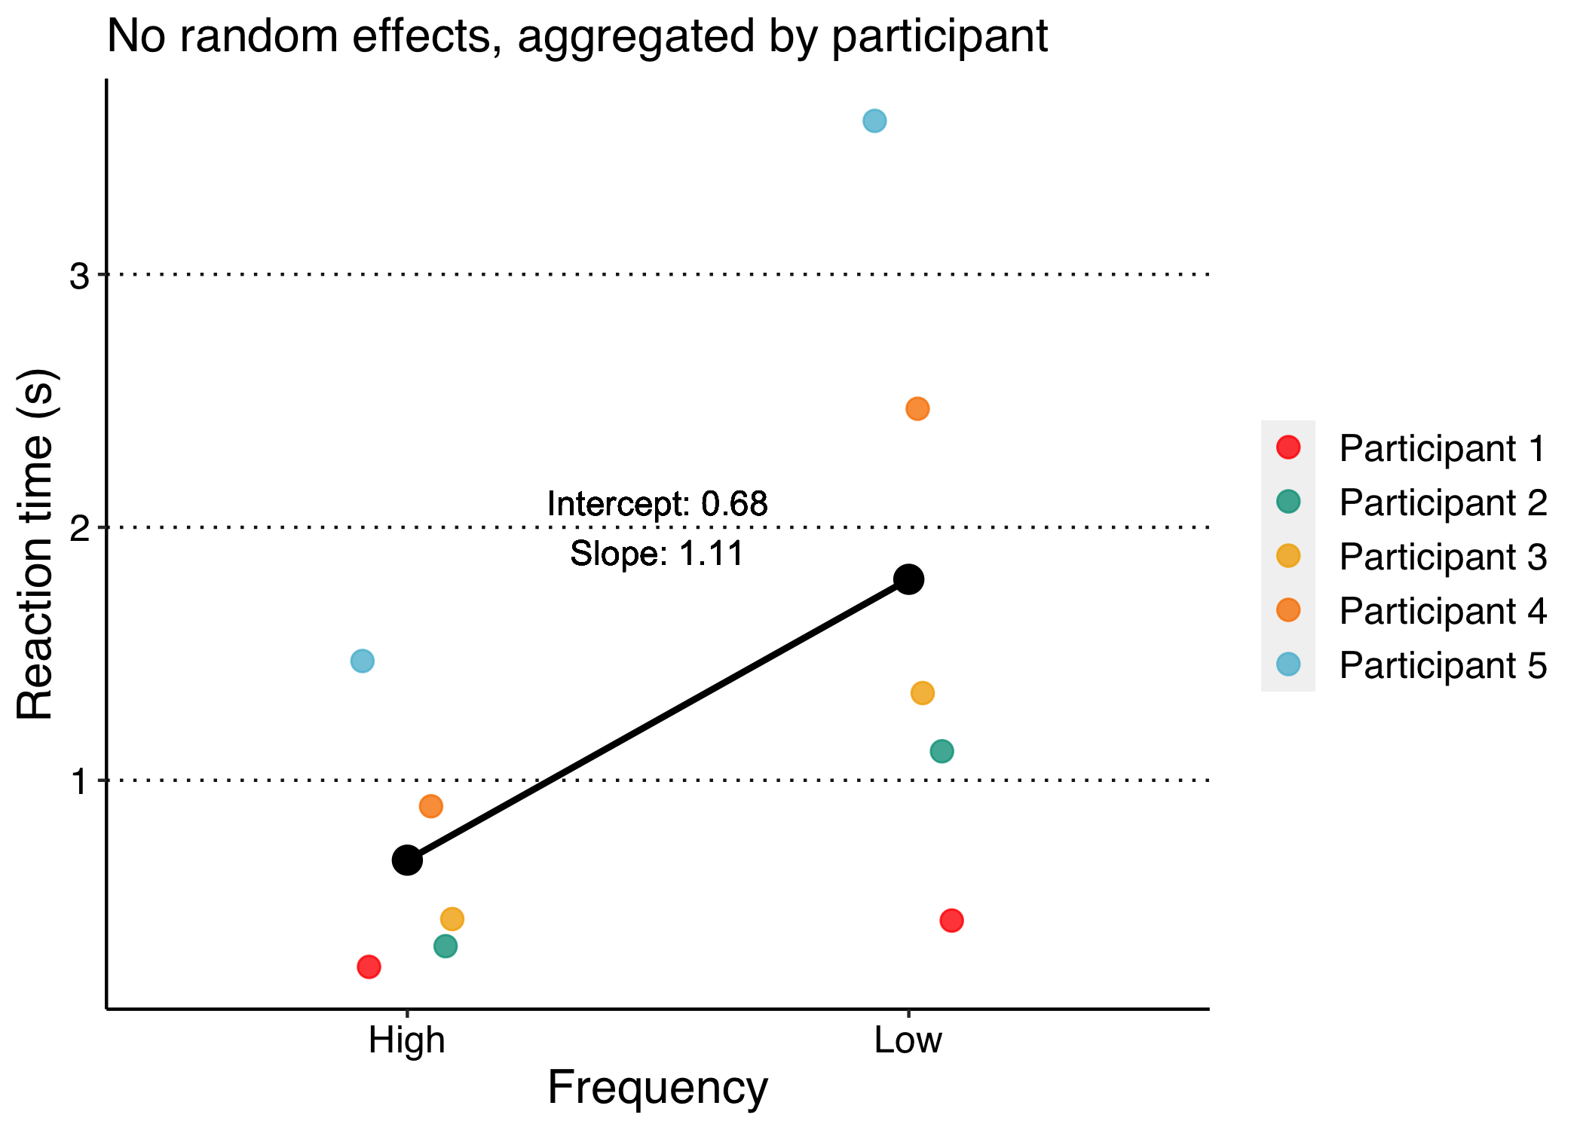
Why to use a LMM
The problem of non-independence seems solved, but at the cost of statistical power: less observations.
There is another way of dealing with no independence and not losing data.

Slide 40
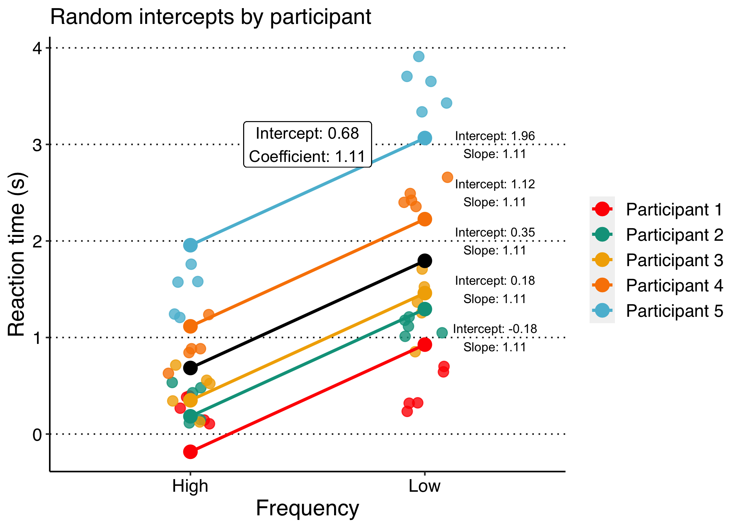
Why to use a LMM
We can include random intercepts by participant. Each participant will have its own baseline.
We will fit a model with same slope but different intercept for each participant.
We account for non-independence: residual is assumed to be random within-participant.
We avoid aggregating datapoints.

Slide 41
Why to use a LMM
Participants may differ in how much they are affected by the experimental condition.
e.g., slower participants may be more affected by low-frequencies than faster participants.
The slope of the predictor frequency on each participant may be different.
Data points from the same participant may be still correlated.
We can account for this variability by adding random slopes of frequency by participant.
Notes:
There is yet another source of systematic variability we may not be accounting for:

Slide 42
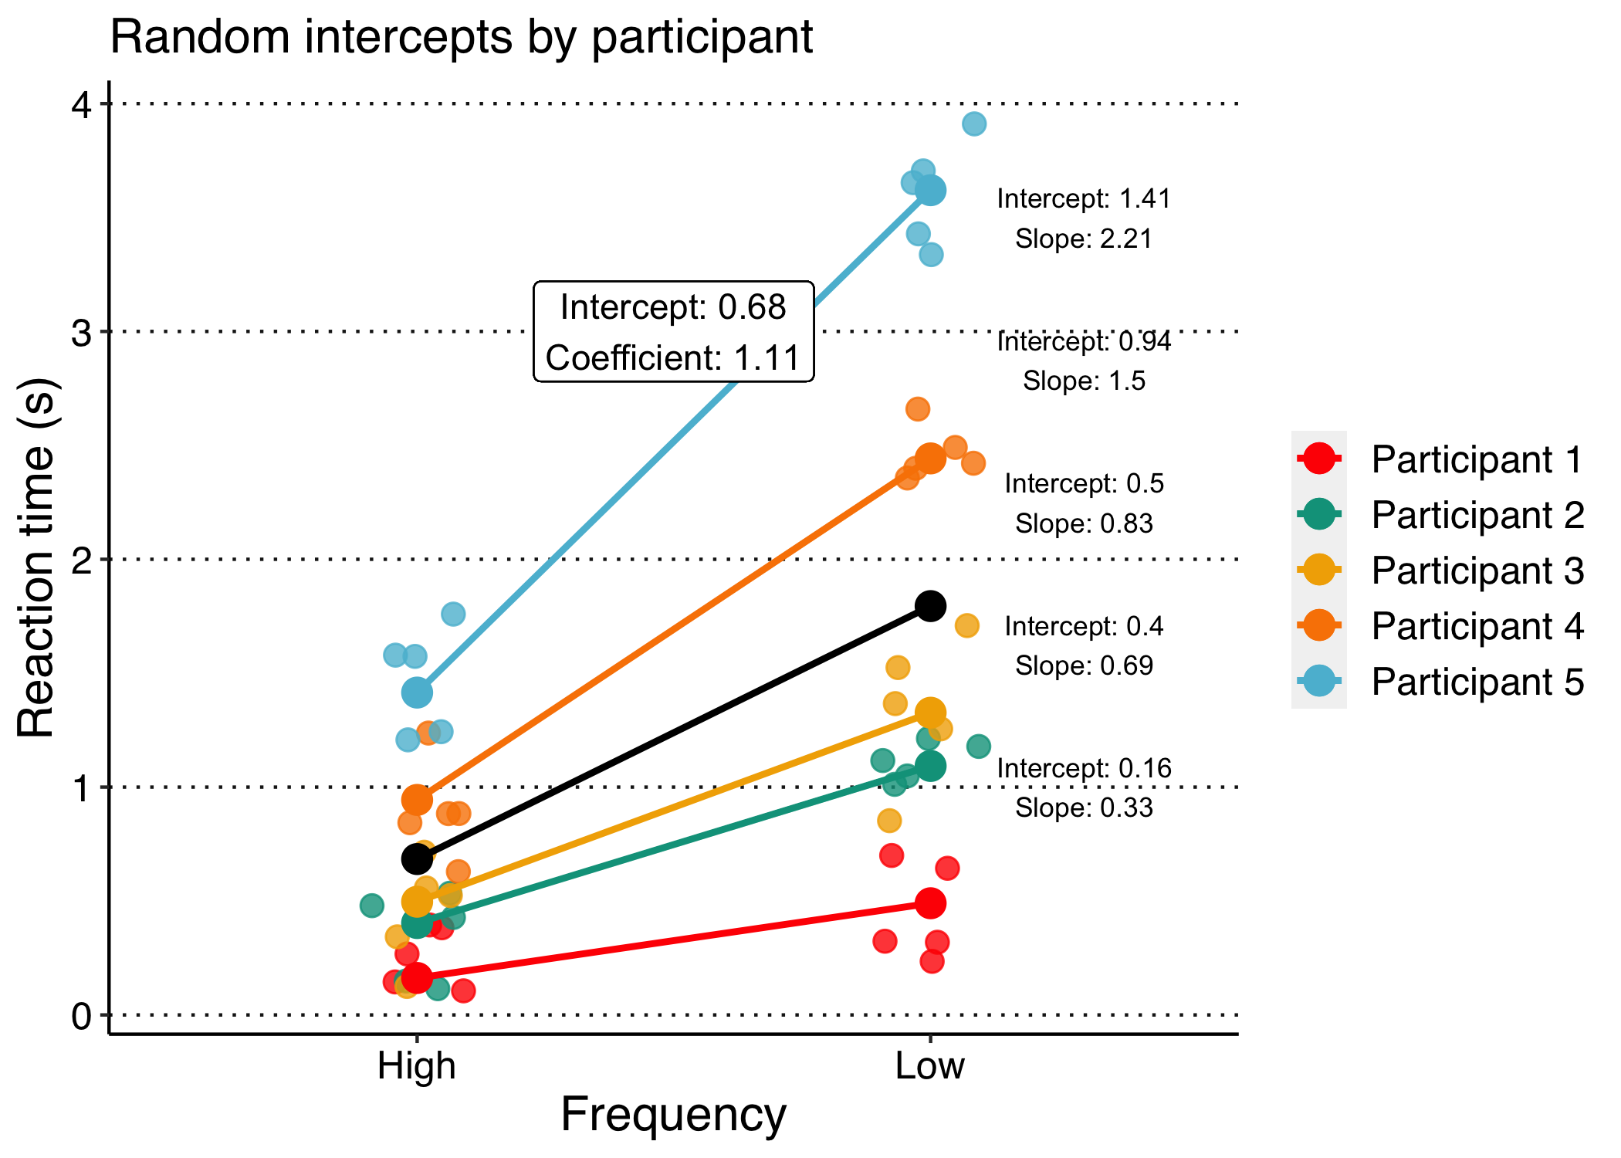
Why to use a LMM
We can include random intercepts and slopes by participant.
Each participant will have its own baseline, and is affected differently by frequency condition.
We will fit a model with diferent intercept and slope for each participant.

Slide 43
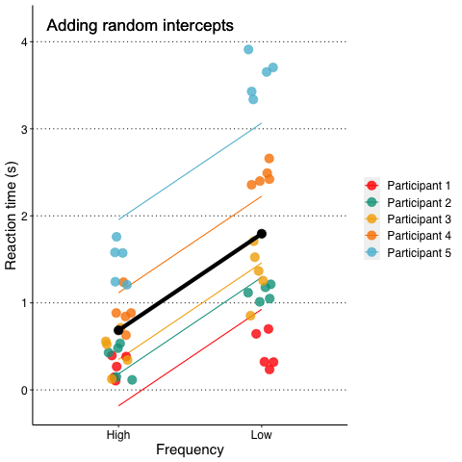
Why to use a LMM
Summary:
LMM allow us to account for systematic sources of variability beyond our fixed effects.
This increases the sensitivity of our experiments.

Slide 44
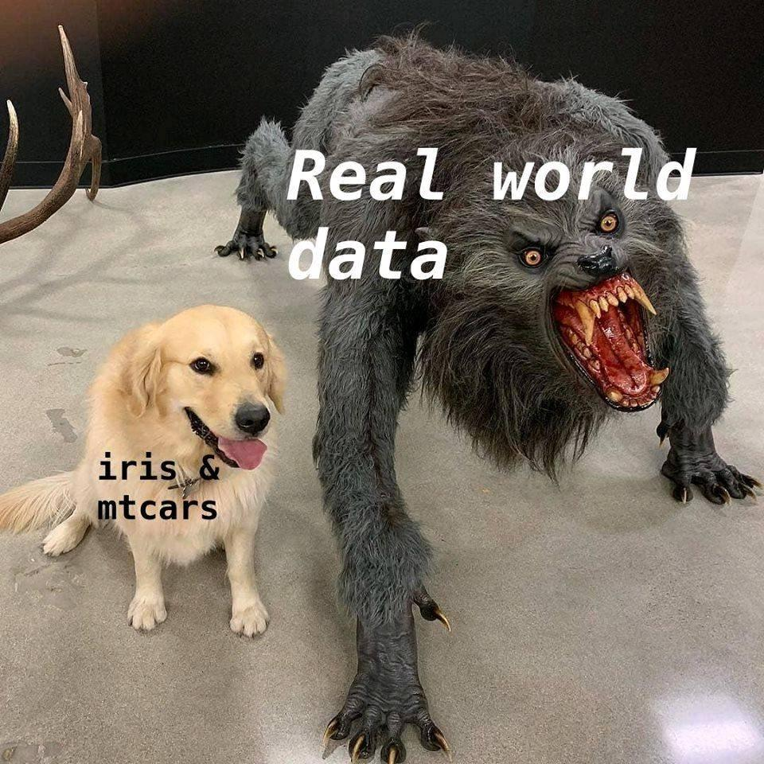
A real-life example
Santolin, García-Castro, Zettersten, Sebastian-Galles and Saffran (2020)
Warning: Product placement ahead.
Notes:
My plan is that everybody can start playing with their own data after this workshop.

Slide 45


How to use LMM
Does previous experience with the Head-turn Preference Procedure (HPP) impact performance in the task?
Santolin, C., García-Castro, G., Zettersten, M., Sebastian-Galles, N., & Saffran, J. (2020, March 4). Experience with research paradigms relates to infants' direction of preference. https://doi.org/10.31234/osf.io/xgvbh
You can find data and code here: https://osf.io/g95ub/

Slide 46
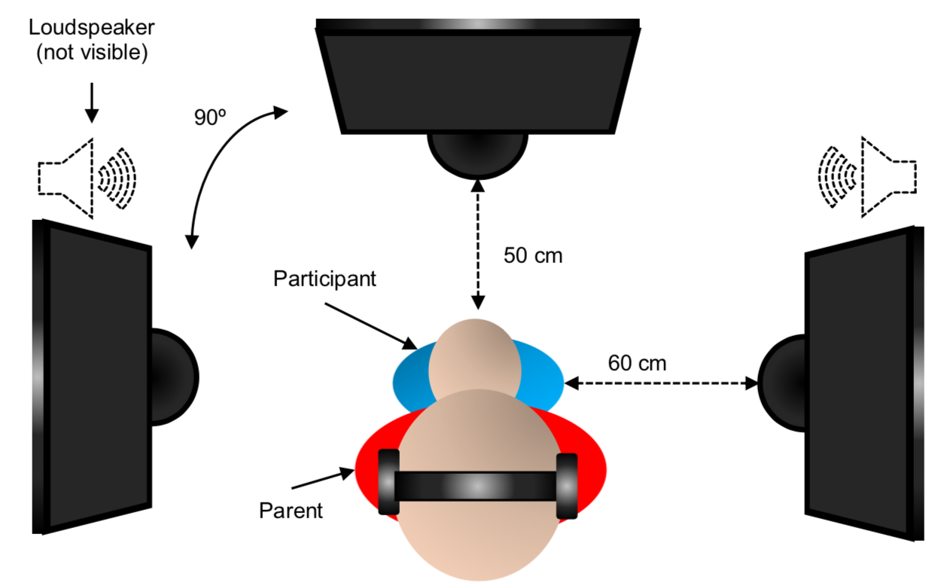
The Head-turn Prefrence Procedure
Looking time to familiar vs. novel items

Slide 47
The data
We gathered data from 6 experiments run two different locations. Only four are shown here, for simplicity:
Laboratori de Recerca en Infància (Universitat Pompeu Fabra, Barcelona)
Waisman Center & Department of Psychology (University of Wisconsin-Madinson, Wisconsin)
Study | HPP
 | 1 | 2 | 3 | 4 | 5 | 6
Saffran & Wilson (2003) | 13 | 12 | 12 | 2 | 1 | - | 40
Saffran et al. (2008) | 2 | 5 | 2 | 2 | - | 1 | 12
Santolin & Saffran (2019) | 9 | 15 | - | 2 | - | - | 26
Santolin, Saffran & Sebastian-Galles (2019) | 22 | 2 | - | - | - | - | 24
 | 46 | 44 | 14 | 6 | 1 | 1 | N = 102

Slide 48
The data
Experiments were broadly similar in design, age of participants, and stimuli type.
There were some cross-study differences:
Different participants
Different countries (i.e., different cultures, lifestyle)
Different languages
Different language profile (predominantly monolinguals in Wisconsin, predominantly bilinguals in Barcelona)

Slide 49
The data
Import the data:

Slide 50
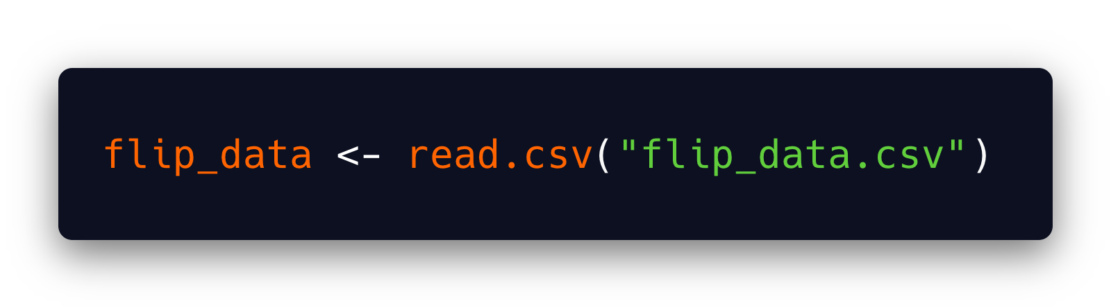
The data
Test item:
0 = Familiar
1 = Novel
Participant | Study | HPP | Item | Looking Time (ms)
1 | Santolin, Saffran & Sebastian-Galles (2019) | 1 | 0 | 6541
1 | Santolin, Saffran & Sebastian-Galles (2019) | 1 | 1 | 4770.83
2 | Santolin, Saffran & Sebastian-Galles (2019) | 1 | 0 | 7654.67
2 | Santolin, Saffran & Sebastian-Galles (2019) | 1 | 1 | 6785.17
3 | Santolin, Saffran & Sebastian-Galles (2019) | 1 | 0 | 3580.25
3 | Santolin, Saffran & Sebastian-Galles (2019) | 1 | 1 | 4501.5
4 | Santolin, Saffran & Sebastian-Galles (2019) | 1 | 0 | 7520.67
4 | Santolin, Saffran & Sebastian-Galles (2019) | 1 | 1 | 5052.83
… | … | … | … | …
102 | Saffran et al. (2008) | 1 | 0 | 3425
102 | Saffran et al. (2008) | 1 | 1 | 4889

Slide 51
Preparing our predictors
We use Looking time (in ms) as the outcome
We will use Item (familiar/novel) and number of previous HPP (numeric, 1-6) as predictors
We expect an HPP by Item interaction:
Previous experience with HPP should impact novel and familiar preference differently.

Slide 52
Preparing our predictors
Coding variables: dummy vs. effect coding.
Model fitting functions like lmer don't care about how you call your factor levels.
It assigns a numeric value to each level.
In our case, Familiar = 0 and Novel = 1 (alphabetical order).
Notes:
How you code your variables changes the information the model provides you.
This type of coding (0s and 1s) is named dummy coding.
If Familiar = 0, and Novel = 1:
Model intercept: Looking time when item is familiar.
Model slopes: Change in looking time when item is novel.

Slide 53
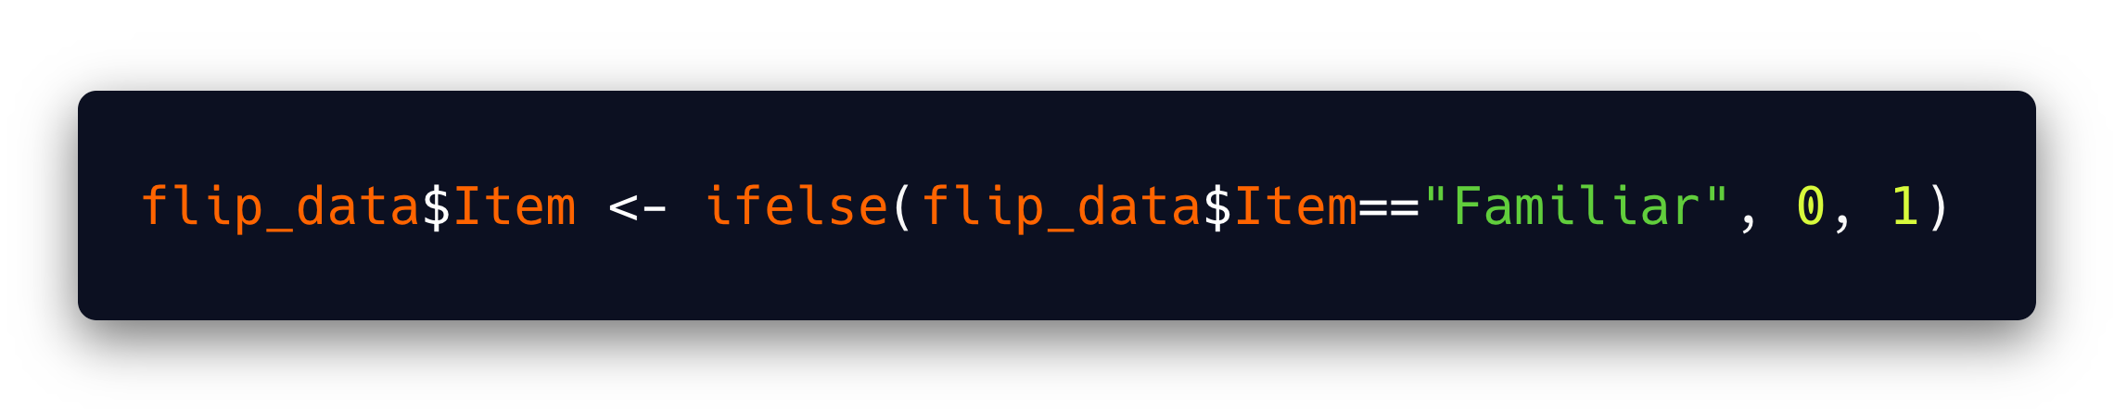
Preparing our predictors
We are interested in interpreting changes in novelty preference. Familiar trials should be the baseline.
The default coding happens to suit us.
But we should should always explicitly recode our predictors based on what information we want them to provide.

Slide 54
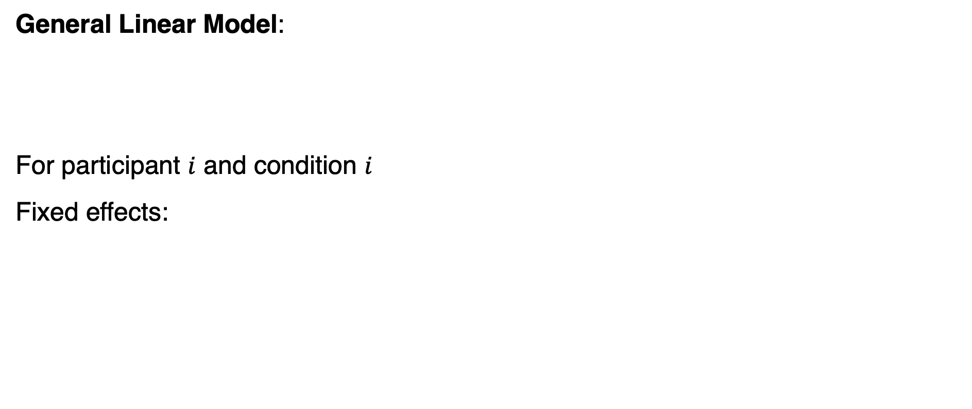
Fixed effects: Model specification
General Linear Model:
For participant $i$ and condition $i$
Fixed effects:
$$Y= β_{0}+β_{1}X_{1}+β_{2}X_{2}+…+β_{j}X_{j}$$
$${{\text{LookingTime}}_{ij}= β}_{0}+β_{1}Item+β_{2}HPP+β_{3}Item×HPP+ε_{ij}$$

Slide 55
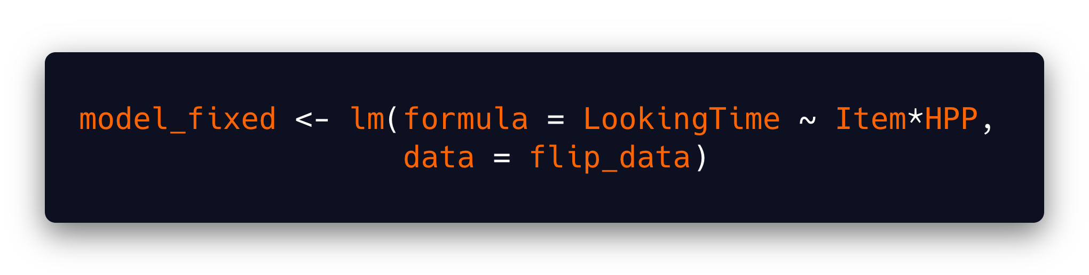
Fixed effect: Model fitting
Dependent variable
Implementing our model in R:
Main effects of predictors and their interaction
Store the outcome in a variable named model_fixed
Call the lm() function
Data frame where variables are

Slide 56
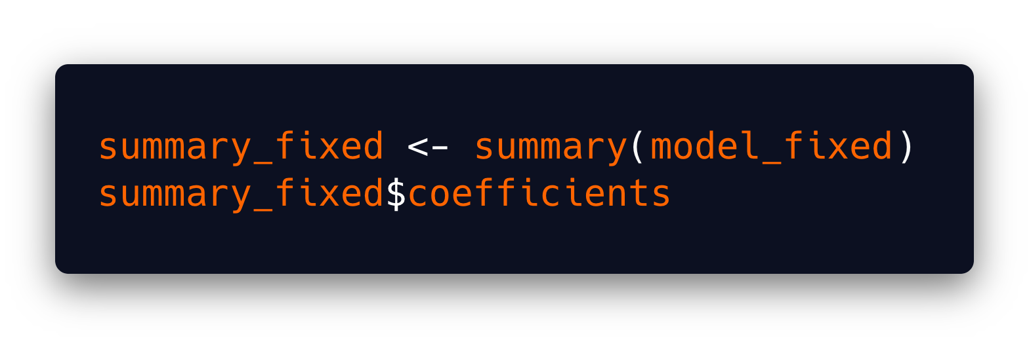
Fixed effects: Statistical inference
Let's take a closer look at the estimates of the model:
The summary function shows the main outcomes of the model (e.g., coefficients)

Slide 57
Fixed effects: Statistical inference
Let's take a closer look at the estimates of the model:
The summary function shows the main outcomes of the model (e.g., coefficients)
Std. Error: How much would each coefficeint vary if we repeated this experiment infinite times?
p-value: probability associated to our t-value assuming that our coefficient is equal to 0
Intercept: What value does our predictor variable take when all predictors are 0
Term | Coefficient | SE | t | p
(Intercept) | 8013.48 | 490.45 | 16.34 | 0.00
Item | -1398.77 | 693.60 | -2.02 | 0.05
HPP | -603.08 | 229.70 | -2.63 | 0.01
Item:HPP | 667.11 | 324.85 | 2.05 | 0.04
Fixed effects
Student’s t: value of the coefficient in the t probability distribution

Slide 58
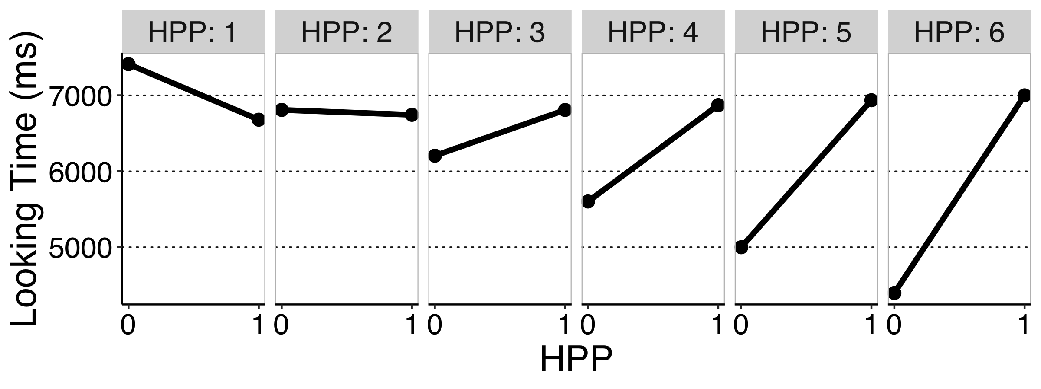
Fixed effects: Model interpretation
Notes:
Interaction

Slide 59
Introducing random effects by participant
Our data is hierarchical:
Every participant provides two data points: one for familiar items and one for novel items.
There are strong reasons to consider that data points from the same participant are correlated.
Some infants are long lookers: high looking times in both conditions Some infants are short lookers: low looking times in both conditions
We should add random intercepts by participant.
Notes:
Hierarchical levels = multilevel models = random models

Slide 60
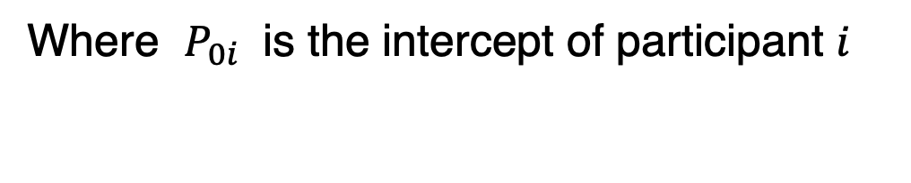
Random intercepts by participant: Model specification
Fixed effects:
Previously:
$${{\text{LookingTime}}_{ij}= β}_{0}+{P_{0i}+β}_{1}Item+β_{2}HPP+β_{3}Item × HPP+ε_{ij}$$
Where $P_{0i}$ is the intercept of participant $i$

Slide 61
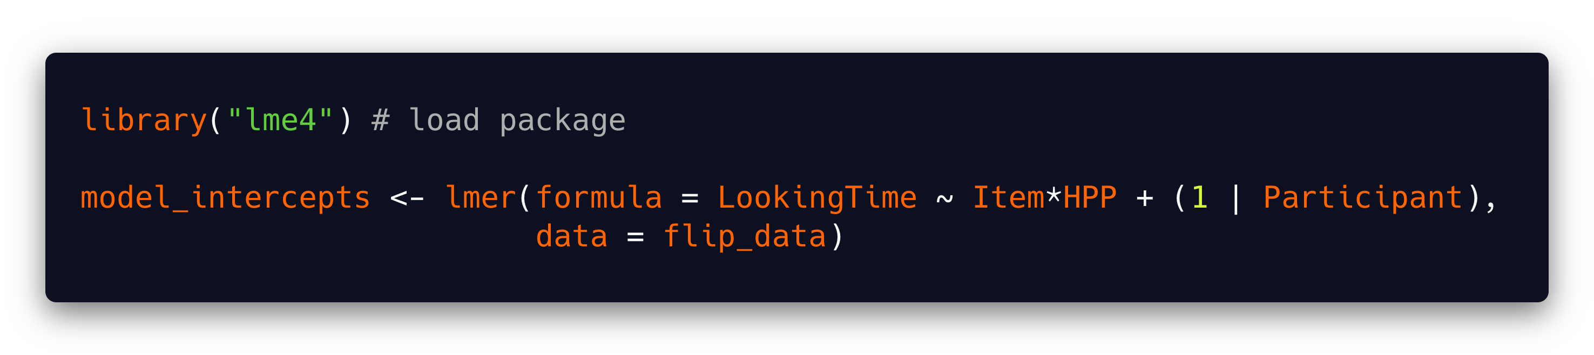
Random intercepts by participant: Model fitting
The lme4 package contains the lmer() function that we need
Random effects: we include a random intercept (1) for each participant

Slide 62
Random intercepts by participant: Statistical inference
Term | Coefficient | SE | t
(Intercept) | 8013.48 | 490.45 | 16.34
Item | -1398.77 | 411.32 | -3.40
HPP | -603.08 | 229.70 | -2.63
Item:HPP | 667.11 | 192.64 | 3.46
Where are my p-values? I want my p-values ☹

Slide 63
Random intercepts by participant: Statistical inference
Computing p-values in LMM is not straightforward.
It's difficult to come map estimates into probability distributions.
Not clear how to pool parameters (many models have been run).

Slide 64
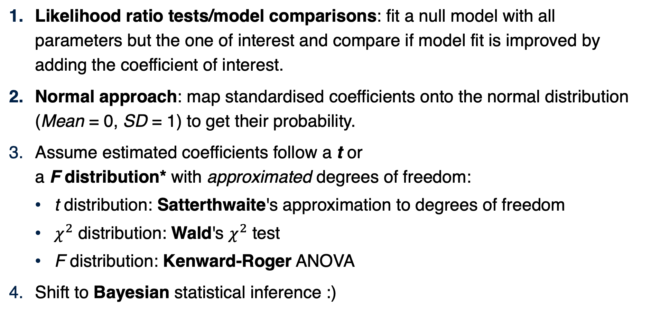
Random intercepts by participant: Statistical inference
Likelihood ratio tests/model comparisons: fit a null model with all parameters but the one of interest and compare if model fit is improved by adding the coefficient of interest.
Normal approach: map standardised coefficients onto the normal distribution (Mean = 0, SD = 1) to get their probability.
Assume estimated coefficients follow a t or a F distribution* with approximated degrees of freedom:
t distribution: Satterthwaite's approximation to degrees of freedom
$χ^{2}$ distribution: Wald's $χ^{2}$ test
F distribution: Kenward-Roger ANOVA
Shift to Bayesian statistical inference :)
Barr et al. (2013)

Slide 65
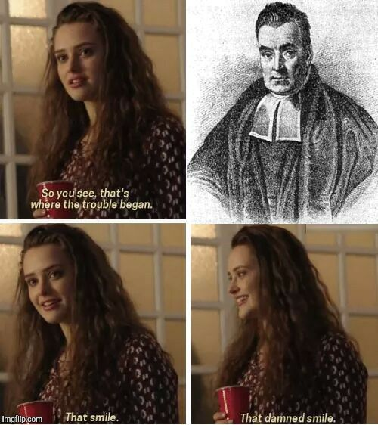
Random intercepts by participant: Statistical inference
Bayesian stats answer complementary questions that sometimes fit better our aims:
e.g., whats the probability that HPP has an effect on looking time to novel trials?
e.g., whats the probability that HPP has no effect on looking time to novel trials?
Notes:
In most context, traditional p-values don’t answer our scientific questions.
Bayesian stats can help us make sense of null results, and sometimes are the only way of really answering our scientific question.

Slide 66
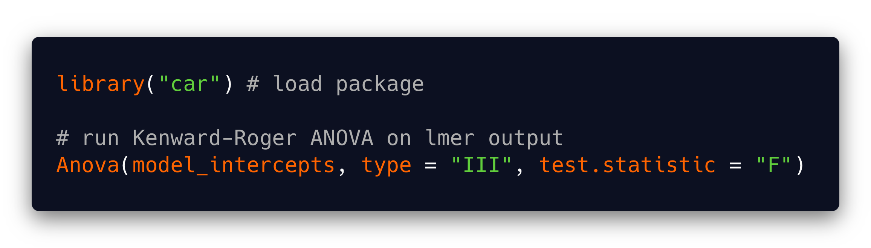
Random intercepts by participant: Statistical inference
The Kenward-Roger F-test is widely recommended.
Term | F | Df | Df den. | p-value
(Intercept) | 266.97 | 1 | 140.81 | 0.00
Item | 11.56 | 1 | 100.00 | 0.00
HPP | 6.89 | 1 | 140.81 | 0.01
Item:HPP | 11.99 | 1 | 100.00 | 0.00

Slide 67
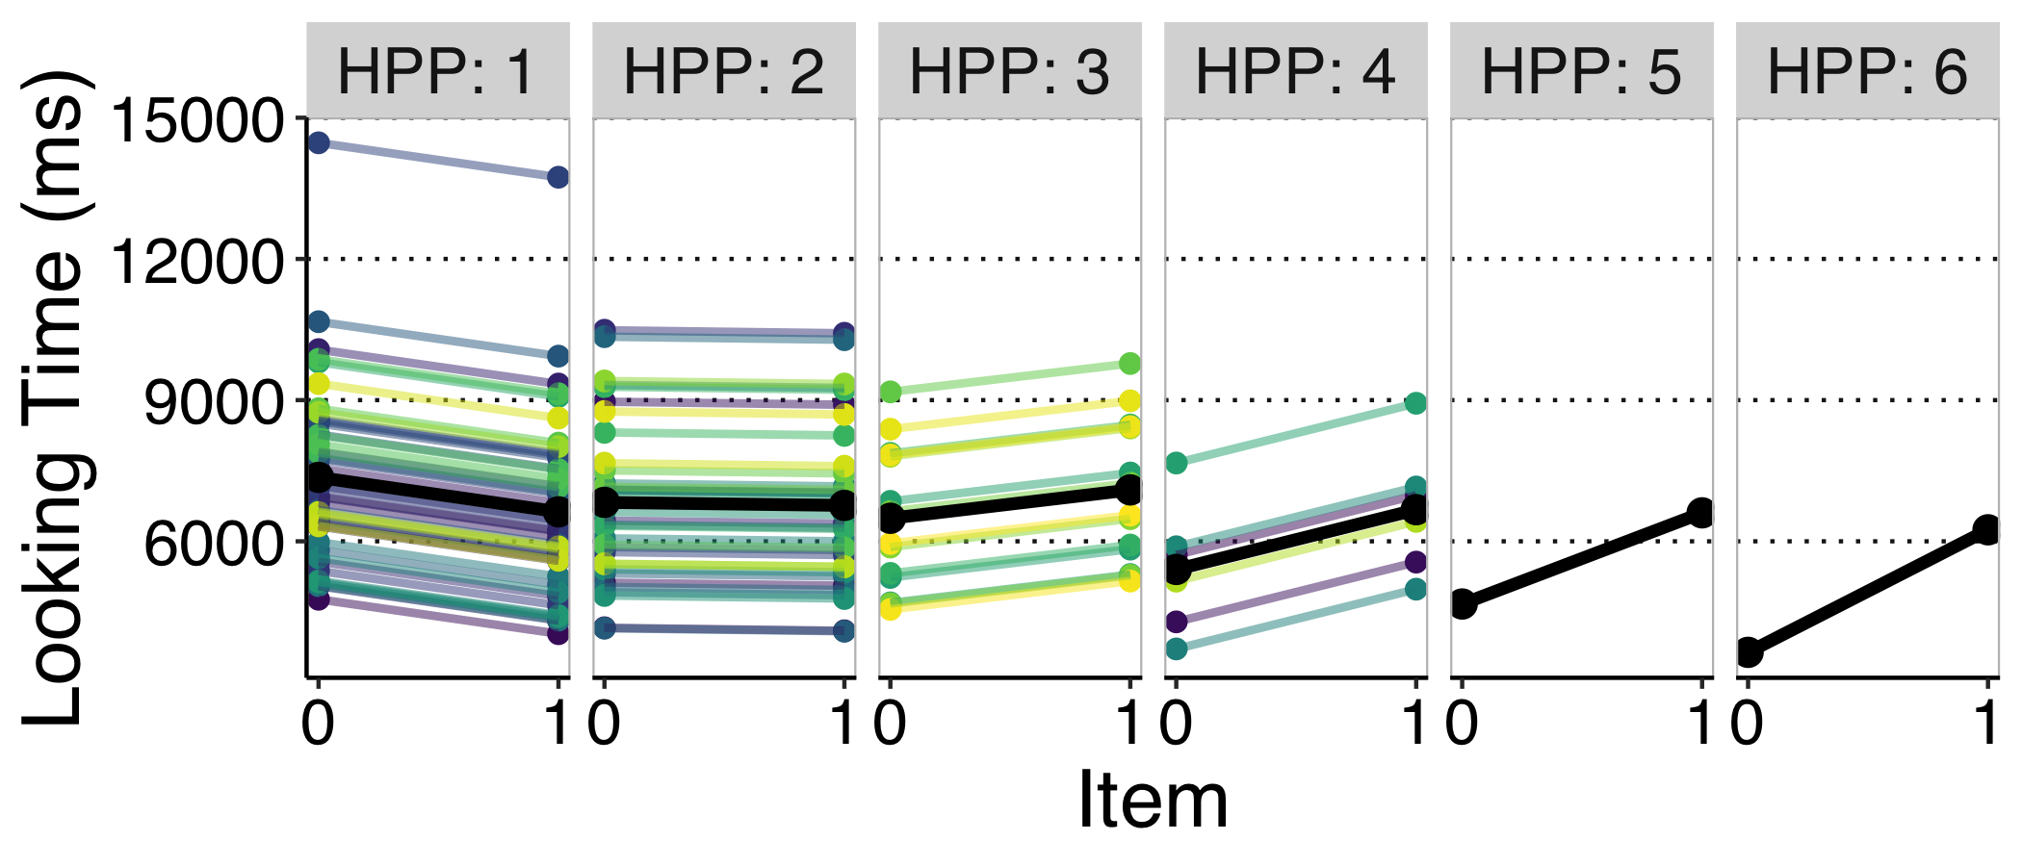
Random intercepts by participant: Model interpretation

Slide 68
Introducing random slopes of Item by participant
There are also reasons to think that the effect of Item varies across infants.
Long-lookers may show higher preferences than others
Some infants may discriminate better than others between familiar and novel items
The slope of Item may vary across infants.

Slide 69
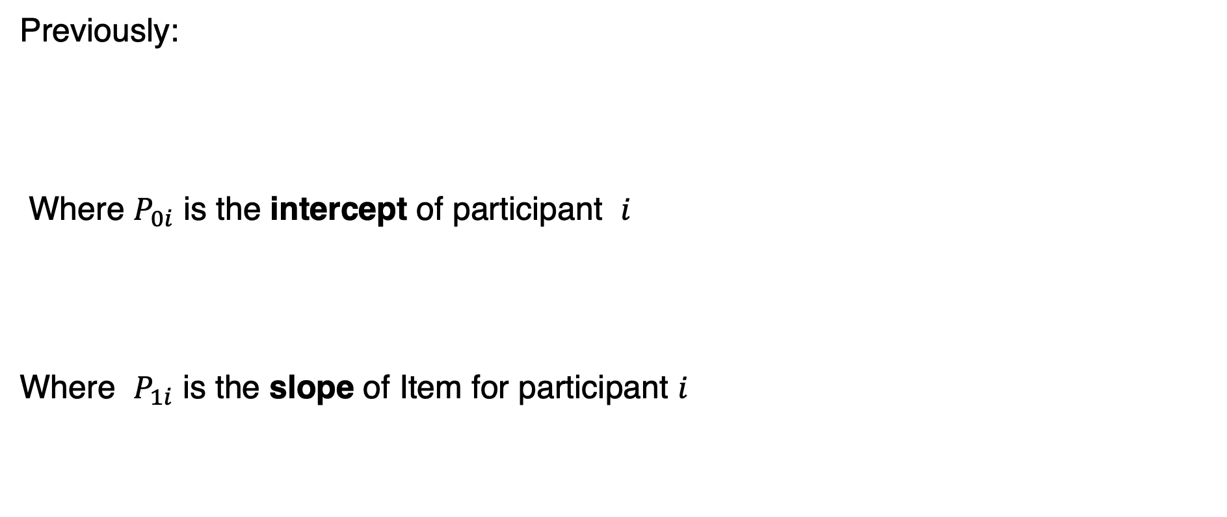
Random intercepts and item slopes by partcipant: Model specification
Previously:
Where $P_{0i}$ is the intercept of participant $i$
Where $P_{1i}$ is the slope of Item for participant $i$
$${{\text{LookingTime}}_{ij}= β}_{0}+{P_{0i}+β}_{1}Item+β_{2}HPP+β_{3}Item×HPP+ε_{ij}$$
$${{\text{LookingTime}}_{ij}= β}_{0}+{P_{0i}+β}_{1}Item+β_{2}HPP+β_{3}Item×HPP+ε_{ij}$$

Slide 70
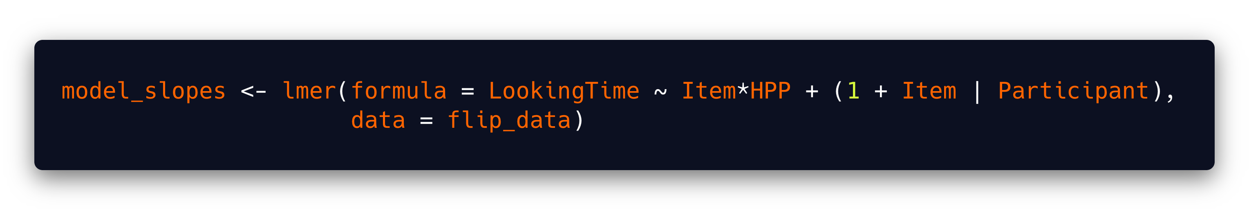
Random intercepts and item slopes by partcipant: Model fitting
Random intercepts: we include a random intercept (1) for each participant
Random slope: We include a random slop (Item) for each participant

Slide 71
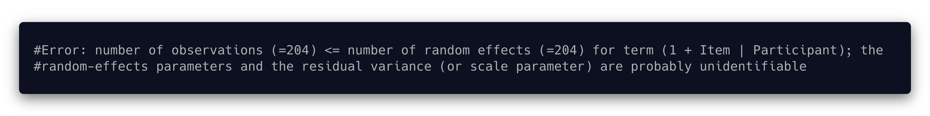
Random intercepts and item slopes by partcipant: Model fitting
Problem: there are a lot of parameters to estimate, and not enough variability.
May be related to some levels of HPP just having one participant.
Check this link out.

Slide 72
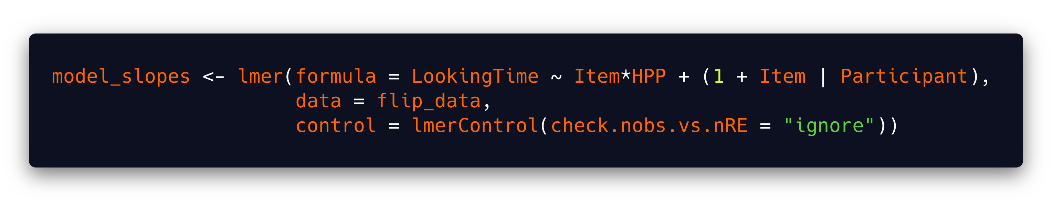
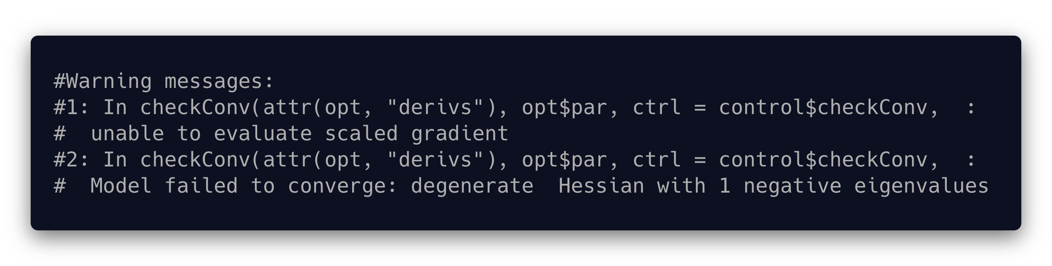
Random intercepts and item slopes by partcipant: Model specification
We can (somehow irresponsibly) force the model to go on:

Slide 73
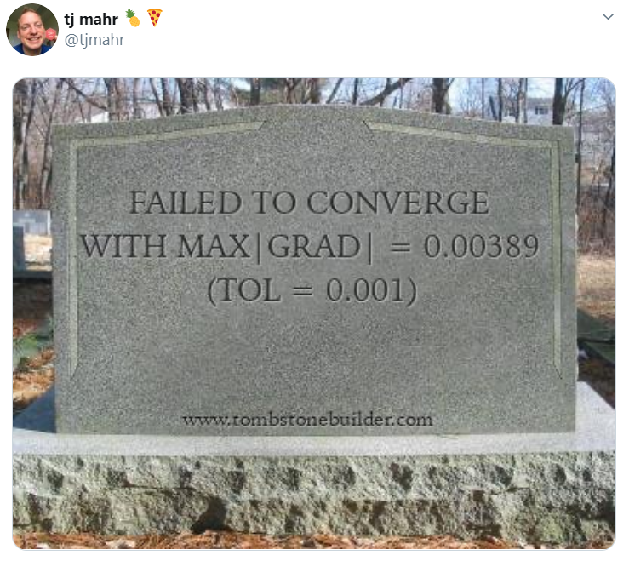
Random intercepts and item slopes by partcipant: Model specification
The model fails to converge (i.e., can't find the most likely coefficients given the data).

Slide 74
Random intercepts and item slopes by partcipant: Model specification
Random item slopes by participant don’t seem blike a goo idea…
Notes:
So, including Item random slopes by participant seems like a bad idea.
Let's stick to by-participants random intercepts only.
But haven't finished getting fancy!

Slide 75
Adding a second random effect
Our model is neglecting another important source of correlation between data points: Study.
Participants are more similar within study than between study.
We can account for this new source of variation by adding Study as a random effect.

Slide 76
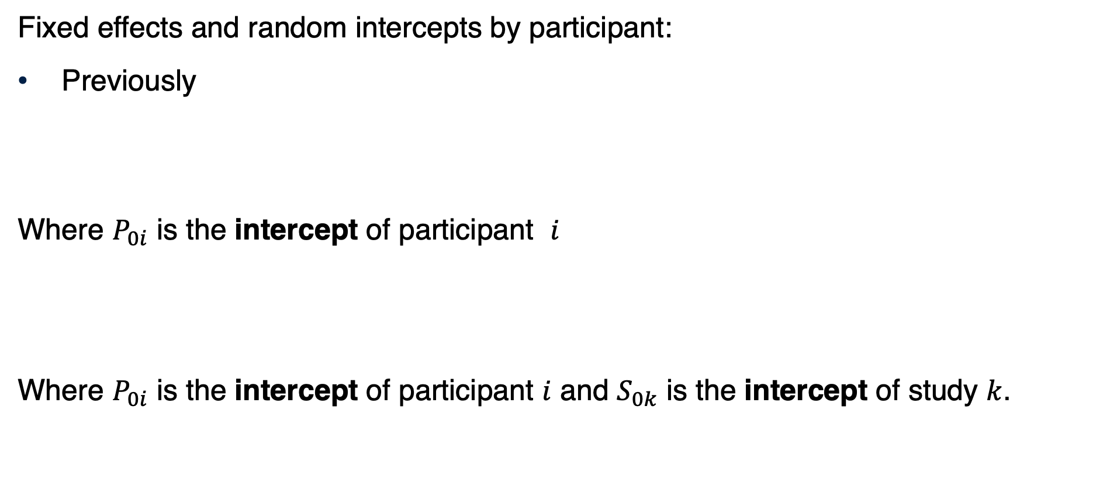
Random intercepts by participant and by study: Model specification
Fixed effects and random intercepts by participant:
Previously
Where $P_{0i}$ is the intercept of participant $i$
Where $P_{0i}$ is the intercept of participant $i$ and $S_{0k}$ is the intercept of study $k$.
$${{\text{LookingTime}}_{ij}= β}_{0}+{P_{0i}+β}_{1}Item+β_{2}HPP+β_{3}Item×HPP+ε_{ij}$$
$${{\text{LookingTime}}_{ij}= β}_{0}+P_{0i}+S_{0k}+β_{1}Item+β_{2}HPP+β_{3}Item×HPP+ε_{ij}$$

Slide 77
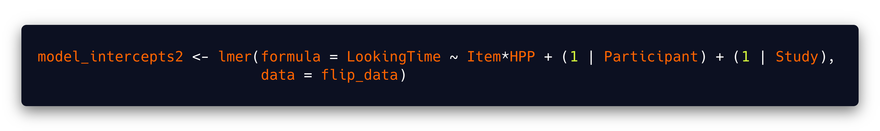
Random intercepts by participant and by study: Model fitting
Random intercepts by participant
Random intercepts by study

Slide 78
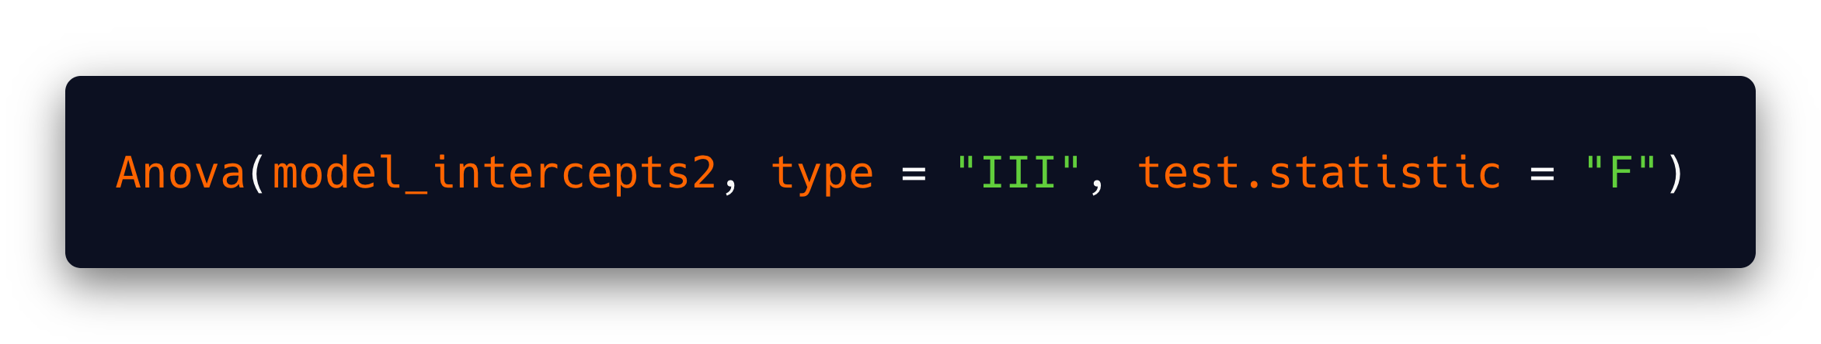
Random intercepts by participant and by study: Statistical inference
Term | F | Df | Df den. | p-value
(Intercept) | 124.69 | 1 | 9.06 | 0.00
Item | 11.57 | 1 | 100.00 | 0.00
HPP | 4.80 | 1 | 133.10 | 0.03
Item:HPP | 11.99 | 1 | 100.00 | 0.00

Slide 79
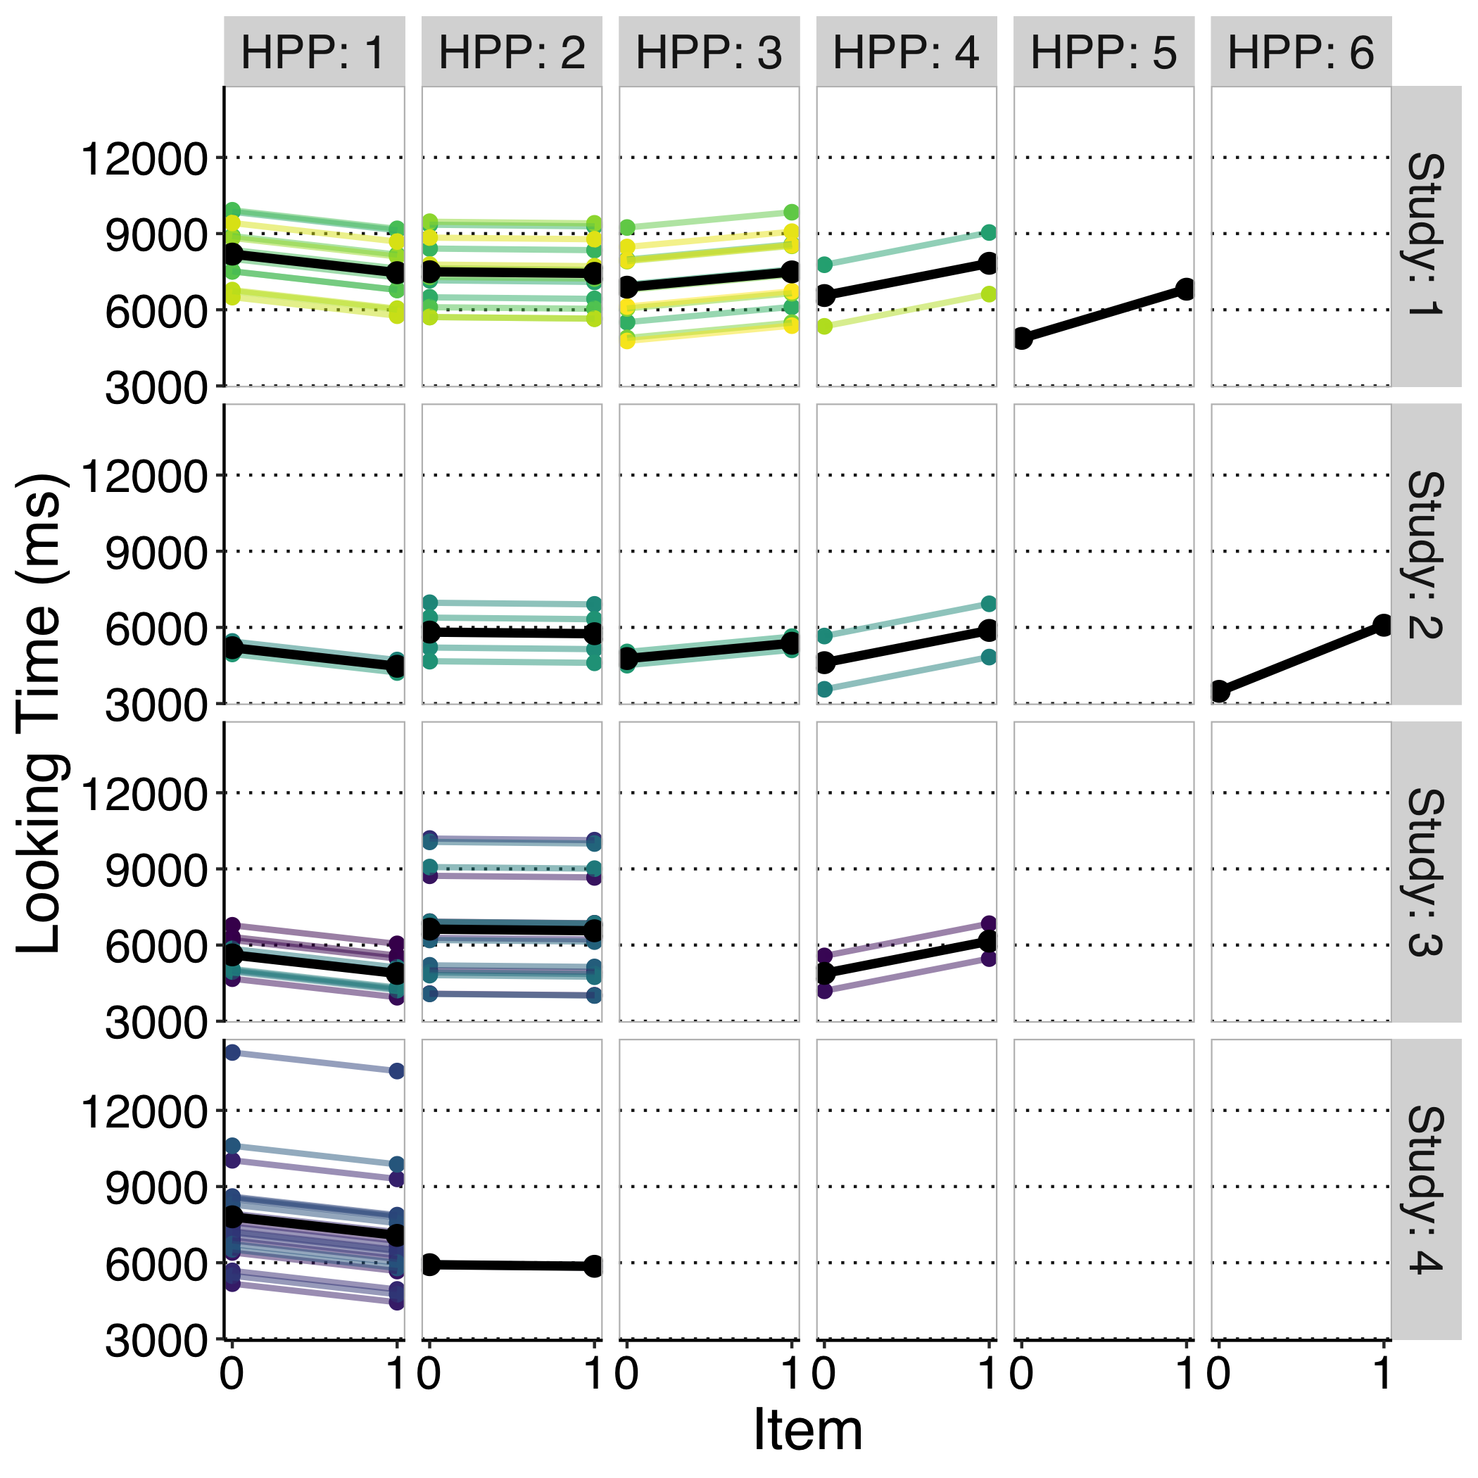
Random intercepts by participant and by study: Model interpretation
We could go on including random effects,
But we for the sake of simplicity, let’s stick to this.

Slide 80
Our final model:
Includes:
Main effects of Item and HPP
Item × HPP interaction
Crossed random effects for participants and study (in contrast to nested random effects; more about this later)
Random by-participant intercepts
Random by-study intercepts

Slide 81
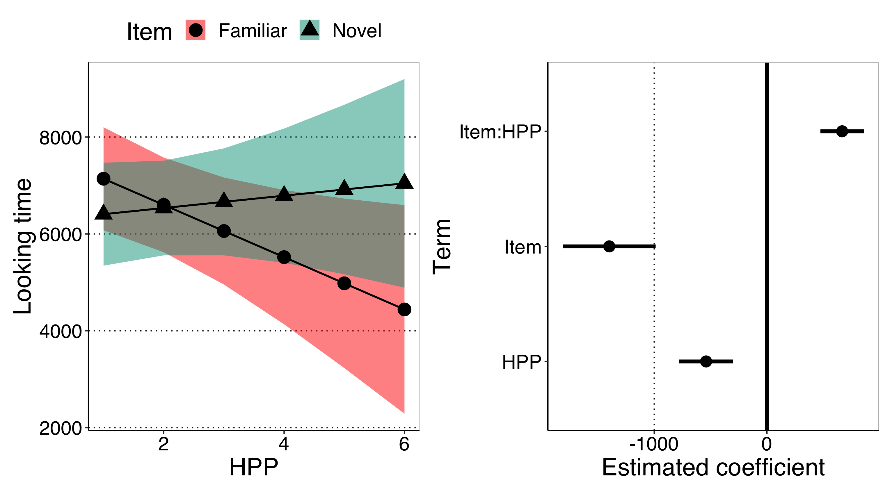
Our final model

Slide 82
Introducing Item random slopes by study
Finally, we can also expect the effect of HPP to vary across studies.
Infants in some studies could have been more sensitive to the effect of previous experience with HPP.

Slide 83
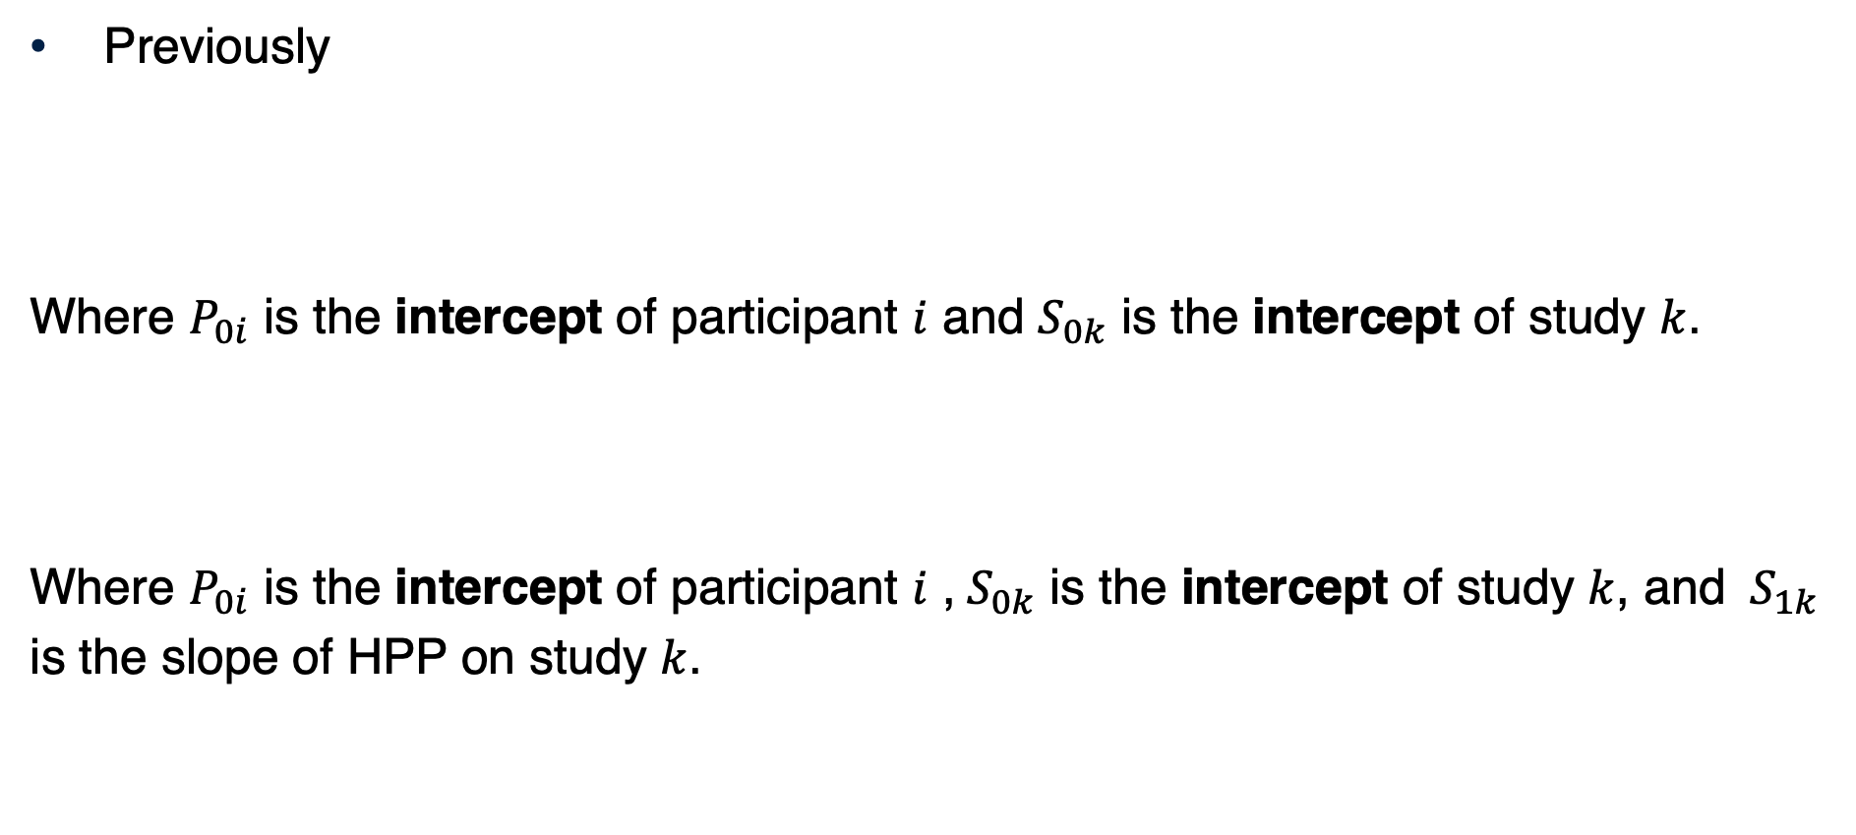
Random intercepts by participant and study, and random HPP slopes by study: Model specification
Previously
Where $P_{0i}$ is the intercept of participant $i$ and $S_{0k}$ is the intercept of study $k$.
Where $P_{0i}$ is the intercept of participant $i$ ,${ S}_{0k}$ is the intercept of study $k$, and ${ S}_{1k}$ is the slope of HPP on study $k$.
$${{\text{LookingTime}}_{ij}= β}_{0}+P_{0i}+S_{0k}+β_{1}Item+β_{2}HPP+β_{3}Item×HPP+ε_{ij}$$
$${{\text{LookingTime}}_{ij}= β}_{0}+P_{0i}+β_{1}Item+{(S}_{1k}+β_{2})×HPP+β_{3}Item×HPP+ε_{ij}$$

Slide 84

Random intercepts by participant and study, and random HPP slopes by study: Model specification
Random intercepts by study
Random intercepts by participant
Random slopes by study

Slide 85
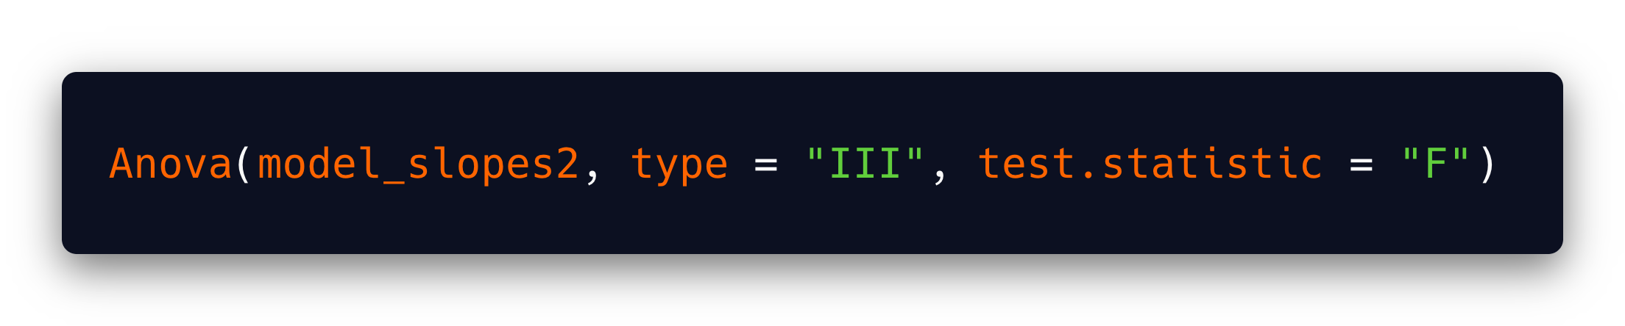
Random intercepts by participant and study, and random HPP slopes by study: Statistical inference
Term | F | Df | Df den. | p-value
(Intercept) | 77.71 | 1 | 3.16 | 0.00
Item | 11.57 | 1 | 100.00 | 0.00
HPP | 2.92 | 1 | 2.62 | 0.20
Item:HPP | 11.99 | 1 | 100.00 | 0.00

Slide 86
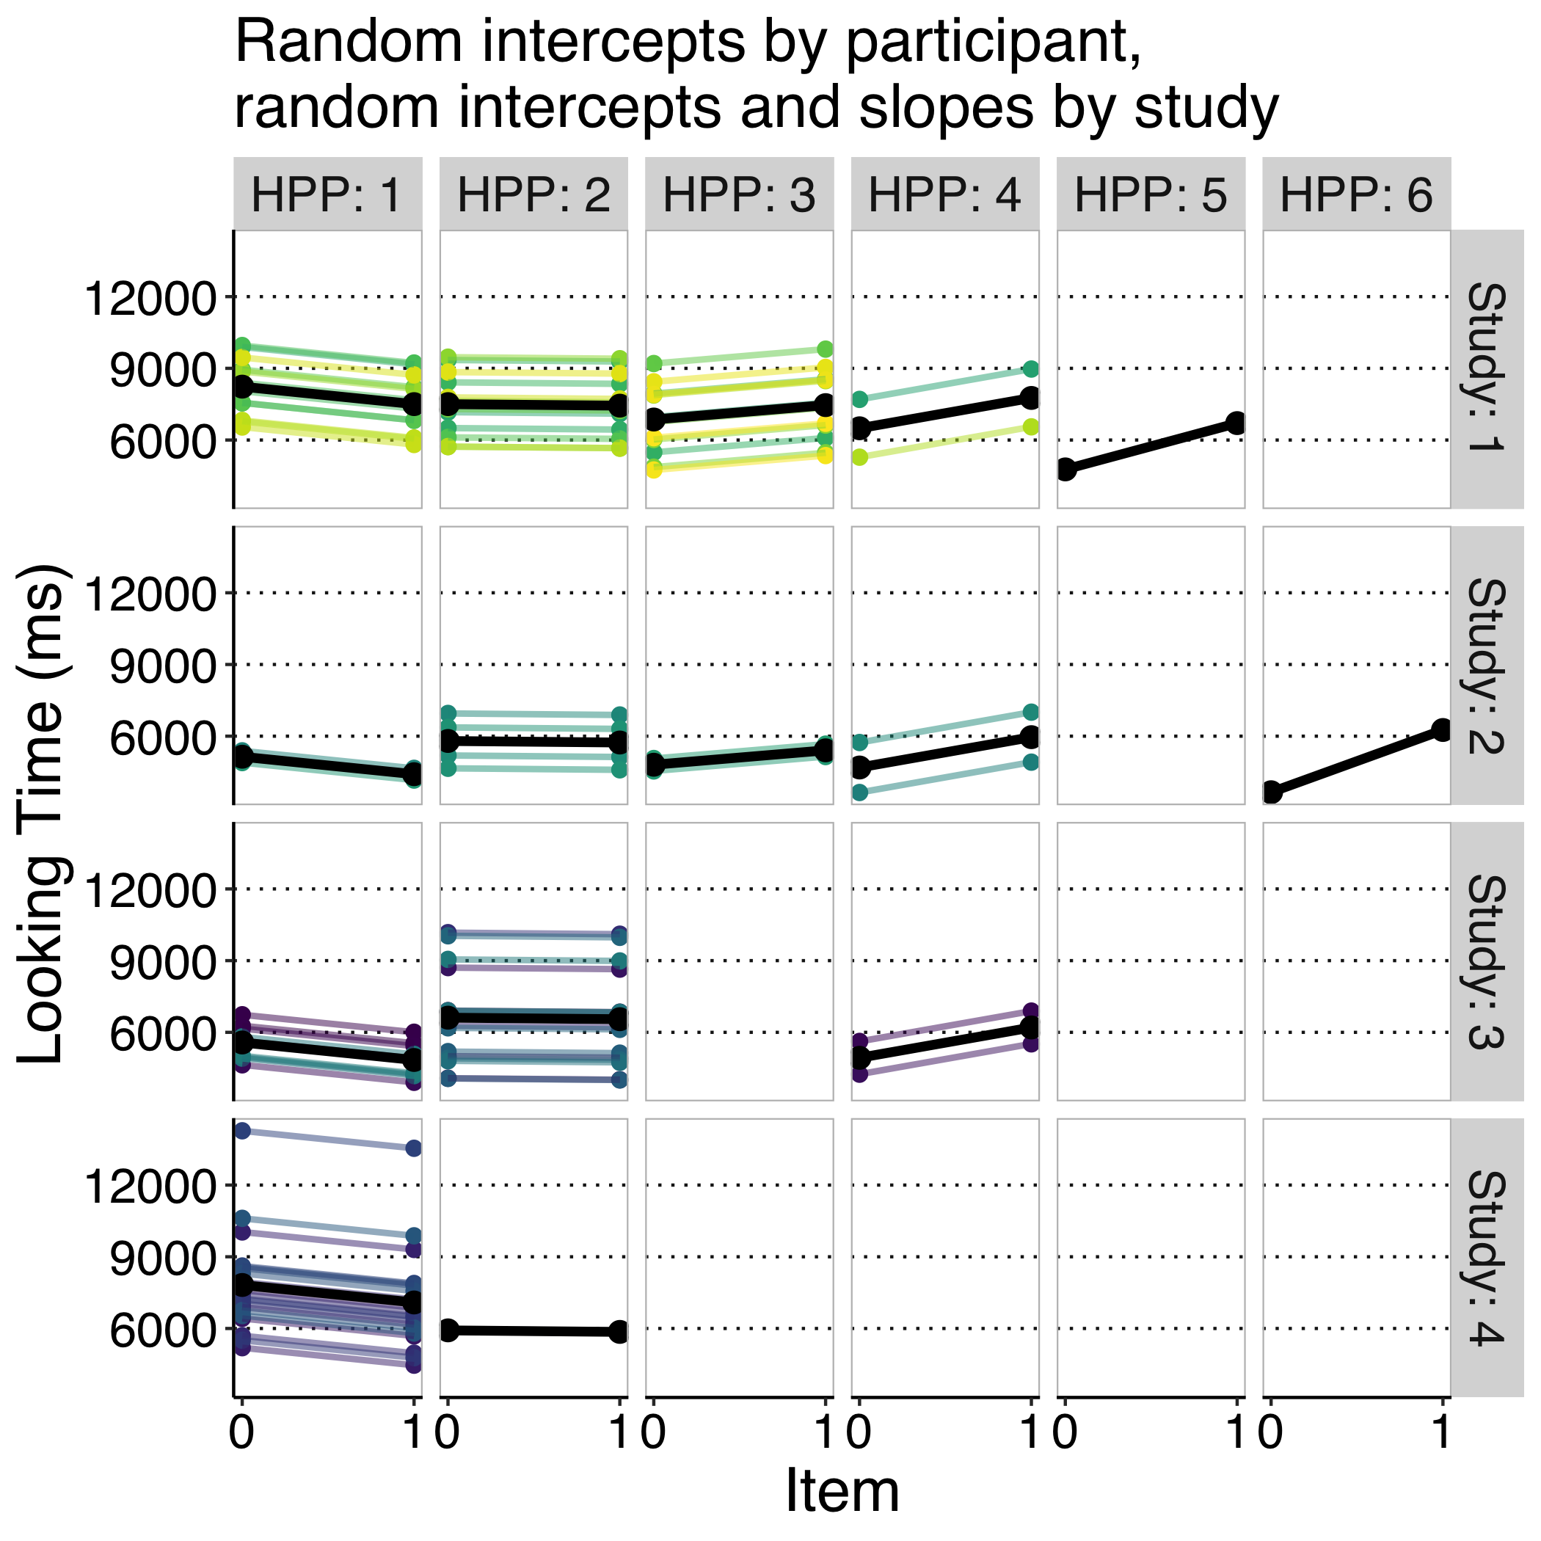
Random intercepts by participant and study, and random HPP slopes by study: Model interpretation

Slide 87
(Parenthesis: Introducing the correlation parameter)
Studies where participants looked longer on average may be those where participants discriminated better between familiar and novel trials.

Slide 88
Some final remarks
Recoding variables, singular fit, convergence, statistical power, and missing data

Slide 89
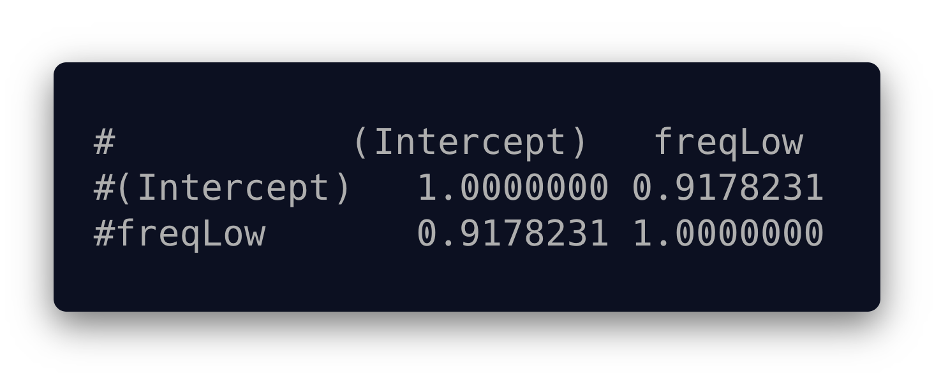
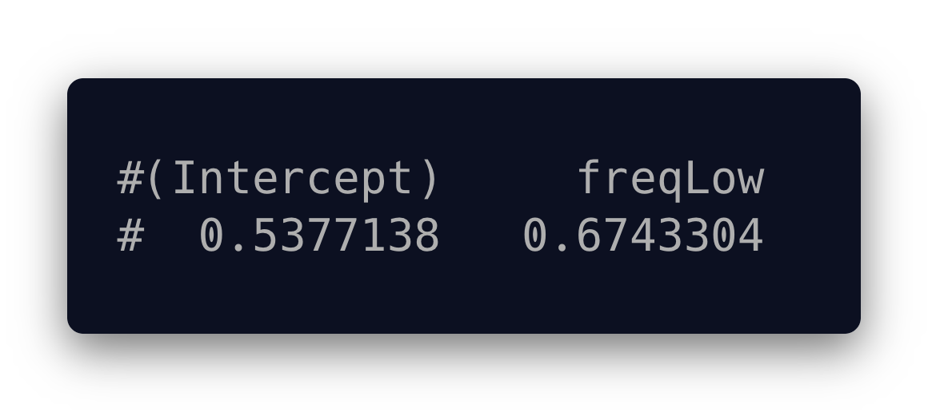
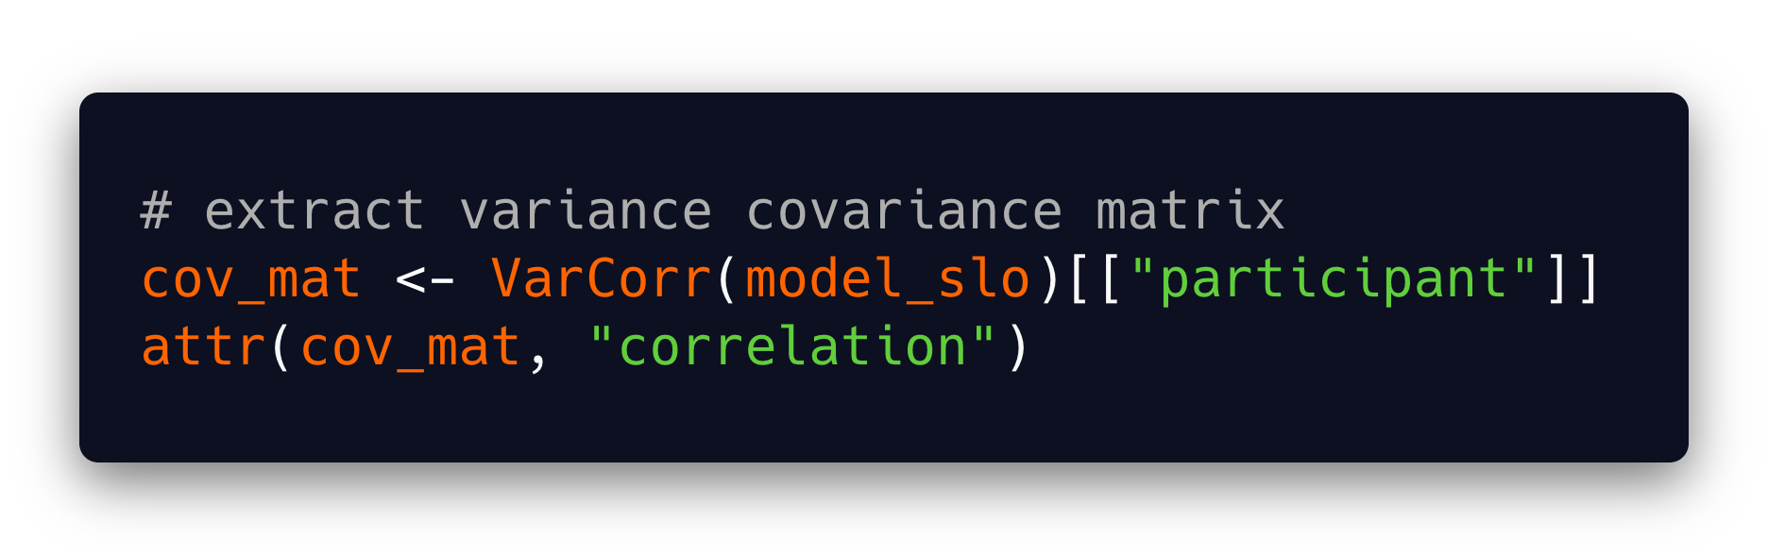

The correlation parameter
Together with $σ$, $ρ$ is calculated for a given random effect, both intercepts and slopes are specified.
These parameters are accessible from the lmer output, in the form of a matrix.

Slide 90
The correlation parameter
The variance-covariance matrix is singular when the correlation parameter is near 1 and/or SD are close to 0.
Our model is over-parameterised.
We should be asking a bit less from the data.
We should make our model more parsimonious (Bates et al., 2015).
Simplify the random effects structure.
More about failure to converge and singular fit later...

Slide 91
Power analysis in Mixed Models
LMM involved the estimation of many parameters.
To perform power analysis, we need to fix some of these parameters
It's difficult to come up with sensible parameters a priori
How much variability am I expecting for each random effect?
How much correlation am I expecting between random effects?

Slide 92
Power analysis in Mixed Models
Also, estimating power analytically (mapping expected parameters onto known distributions) is not straightforward in LMM.
It's not quite clear what parameters we are referring to.
Alternative: shift to simulation-based power analysis. Already available for non-mixed models (e.g., ANOVA). See Lakens and Caldwell (2019) and it's accompanying R package, ANOVApower.
Some methods are already available for mixed-models:
Zhang and Wang (2009): Includes non-linear models, but it's implemented in commercial software (SAS)
DeBruine and Barr (2019)

Slide 93

When our model fails to converge

Slide 94
When our model fails to converge
Sometimes, our model can't figure out what parameters are most likely given the data.
This can be because different values of the same coefficient are equally likely.
How to avoid this:
The larger the data, the easier to converge.
The larger values of the coefficients the more difficult to converge. Consider:
Changing units of measurement: use seconds instead of milliseconds (Barr, 2008).
Consider standardising your predictors.
Don't get too fancy with your model: the more parsimonious, the better (less parameters to estimate).

Slide 95
Recoding predictors
Dummy coding Item makes sense because we have a clear baseline.
Alternatively, we could have effect-coded the predictor Item.
Familiar = -0.5, Novel = 0.5
In this case, the intercept (the looking time when Item = 0) would inform us about the average looking time across conditions.
How we have coded our variables impacts our conclusions especially when interpreting intercepts and main effects if we include interactions in our model.
We'll come back to this later.

